Slide 1



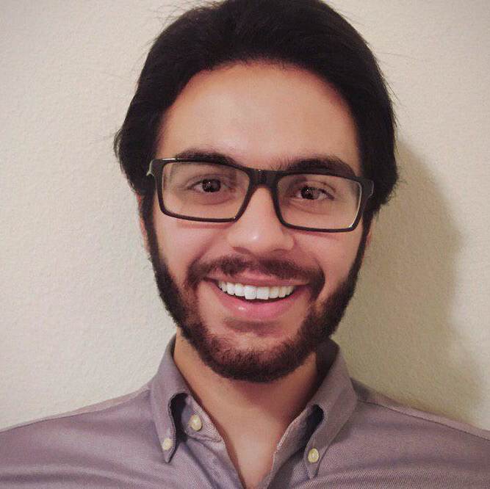
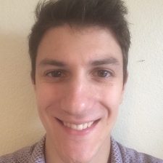
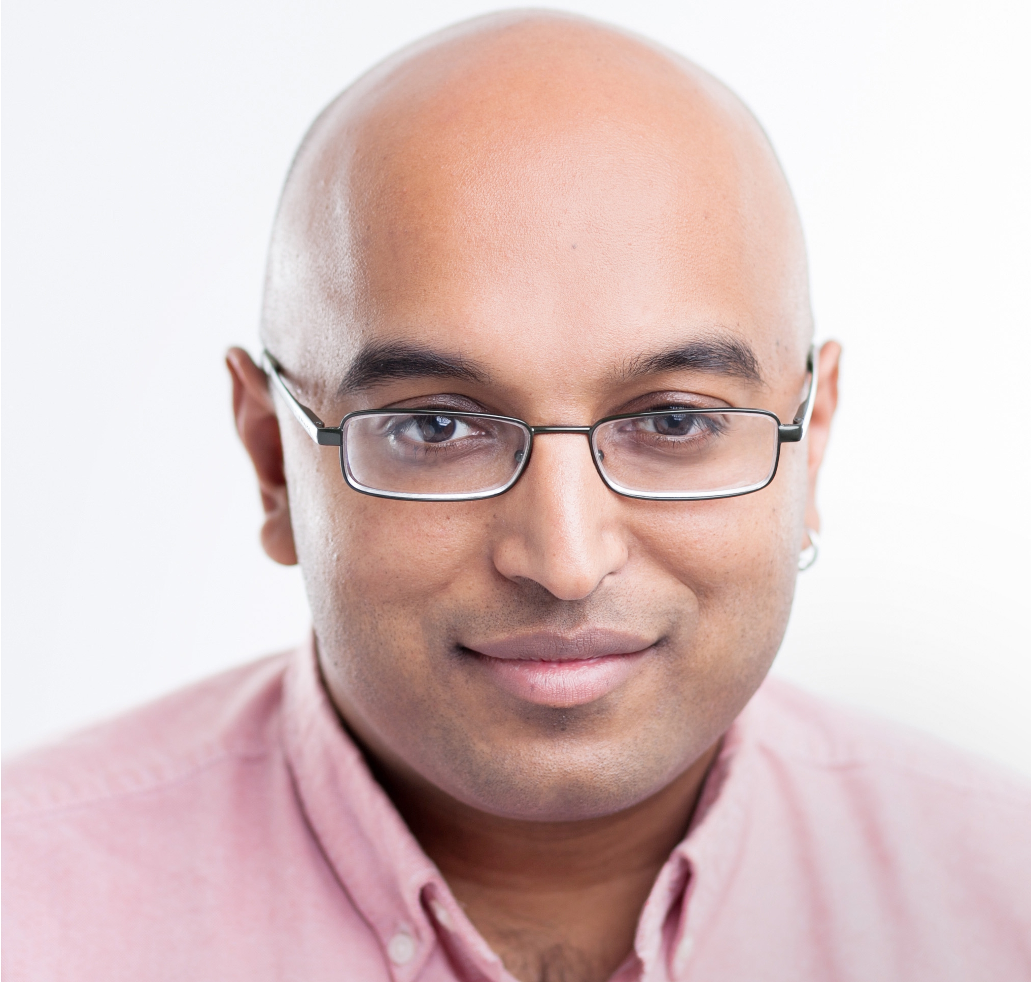
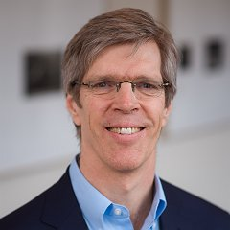
Probabilistic programming
with programmable variational inference
McCoy Becker*
Alex Lew*
Xiaoyan Wang
Matin Ghavami
Mathieu Huot
Vikash Mansingkha
Martin Rinard
Notes:
Hi everyone – I’m McCoy, today I’ll be discussing some joint work with my co-author Alex Lew, lab members from the Probabilistic Computing Project, Martin Rinard, and my advisor Vikash Mansingkha investigating the operations involved in variational inference, and how to automate them efficiently for probabilistic programming languages.

Slide 2


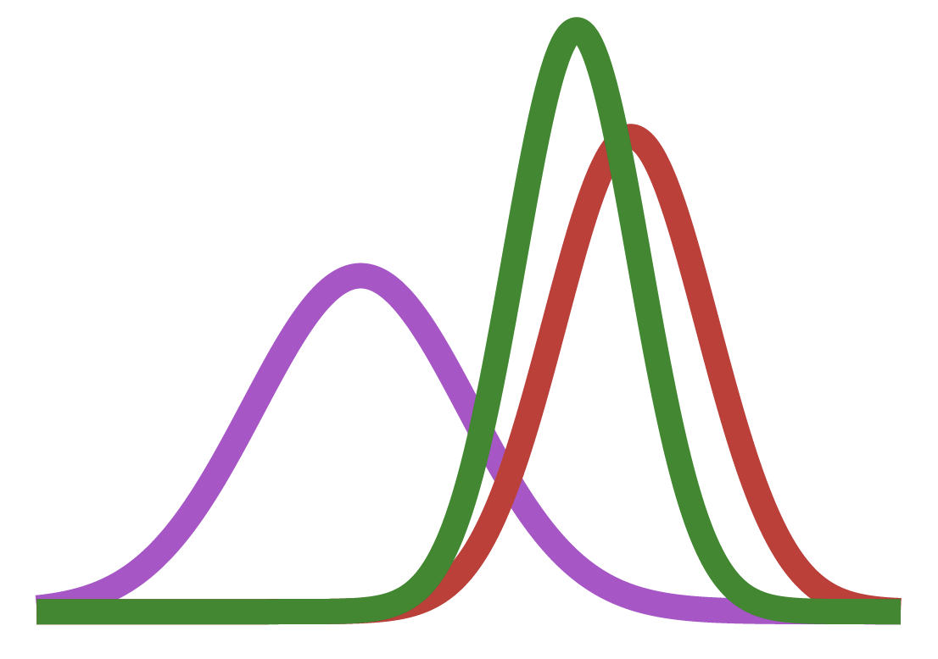




Probabilistic programming today – languages for authoring probability distributions
Gen
Pyro
Turing
SPPL
Birch
Stan
PyMC
and many
more…
Notes:
Probabilistic programming languages are systems that support authoring probability distributions.
Several such systems exist, and each system provides some form of automation for denoting probability distributions using programs, and probabilistic reasoning tasks like conditioning a distribution on data to induce and solve probabilistic inference problems.

Slide 3
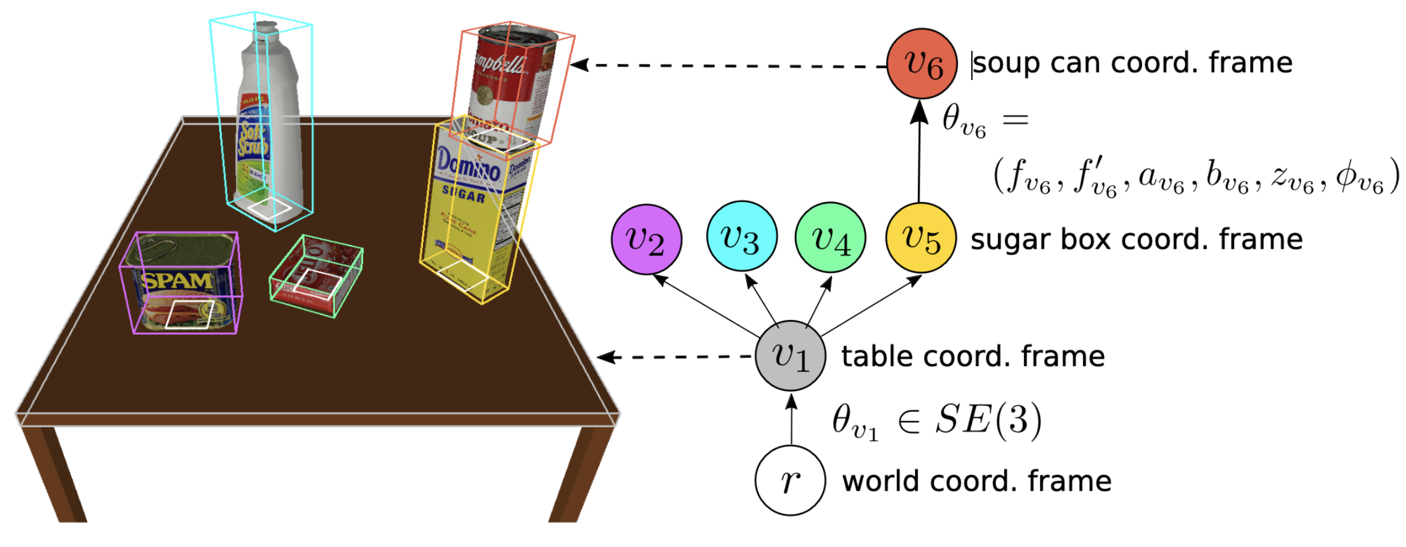
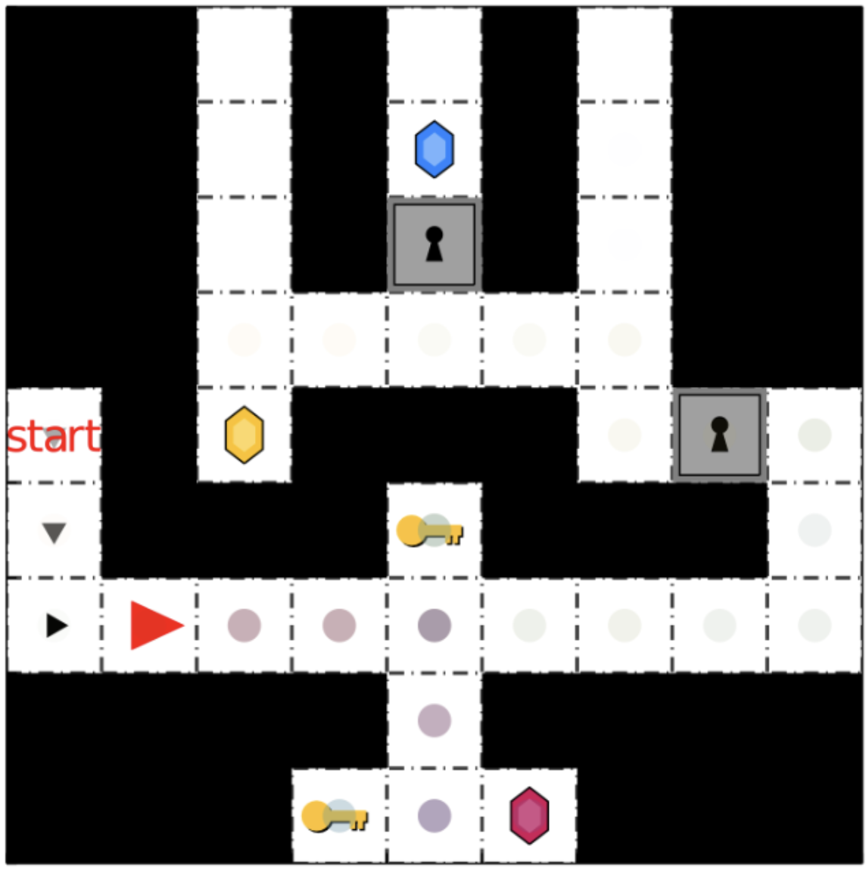
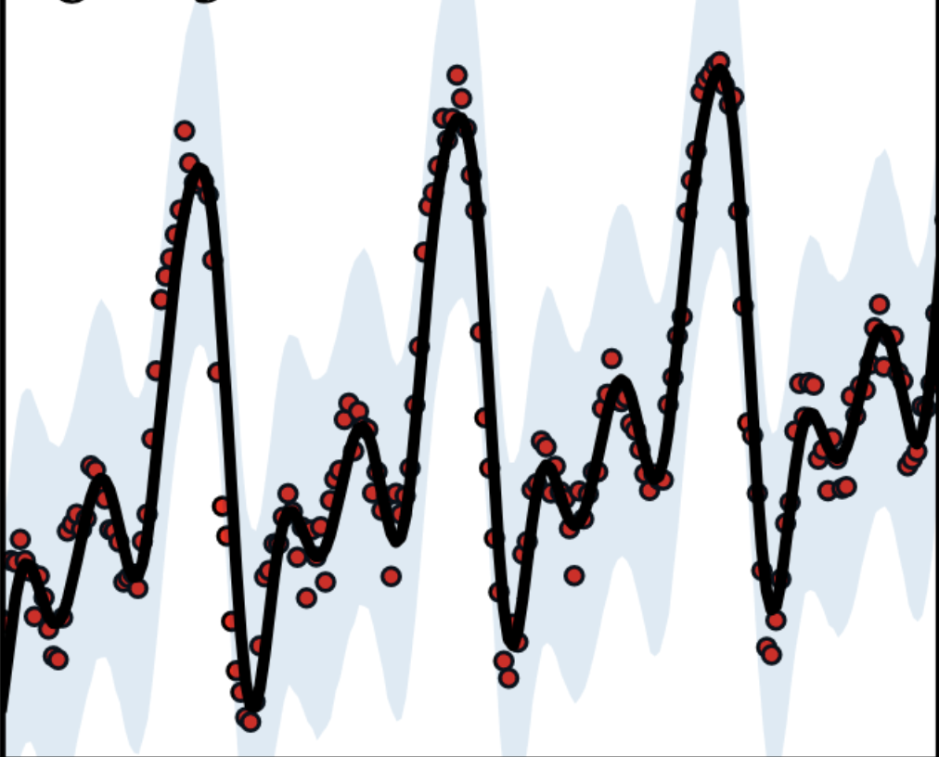
General purpose PPLs
allow models to use
3D rendering
Symbolic planners
Program DSLs
Gen
Pyro
3D Scene understanding
(Gothoskar et al, 2021)
Bayesian goal inference
(Zhi-Xuan et al, 2020)
Time series structure discovery
(Saad et al, 2023)
Notes:
Inference automation is a big concern of these systems. There’s a fundamental trade off between the complexity of distributions which the system allows a user to express, and guarantees around solving inference problems induced on the distributions.
Systems like Gen and Pyro support highly complex distributions, including ones which utilize processes like rendering, planning, and program synthesis…
But solutions to inference problems induced by these distributions are necessarily approximate, and probabilistic programming systems rely on two workhorse families of approximate inference algorithms to solve these inference problems.

Slide 4
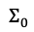

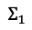
General purpose PPLs
allow models to use
3D rendering
Symbolic planners
Program DSLs
Gen
Pyro
3D Scene understanding
(Gothoskar et al, 2021)
Bayesian goal inference
(Zhi-Xuan et al, 2020)
Time series structure discovery
(Saad et al, 2023)
and rely on
$$Σ_{1}$$
move
around to
sample from
change $Σ$
to look like
$$Σ_{0}$$
Monte Carlo methods
Variational inference methods
to perform approximate inference.
Notes:
These two families are Monte Carlo methods, and variational inference, or VI for short.

Slide 5
General purpose PPLs
allow models to use
3D rendering
Symbolic planners
Program DSLs
Gen
Pyro
3D Scene understanding
(Gothoskar et al, 2021)
Bayesian goal inference
(Zhi-Xuan et al, 2020)
Time series structure discovery
(Saad et al, 2023)
and rely on
Significant formalism, automation, and programmability
No formal language semantics, restricted programmability
$$Σ_{1}$$
move
around to
sample from
change $Σ$
to look like
$$Σ_{0}$$
Monte Carlo methods
Variational inference methods
to perform approximate inference.
Notes:
The good news is that general purpose systems like Gen and Pyro offer forms of automation for both of these classes of algorithms.
The bad news is that, in contrast to Monte Carlo methods, which have significant formalism and automation, variational inference is not well understood formally, and the automation offered by these systems is significantly restricted.

Slide 6
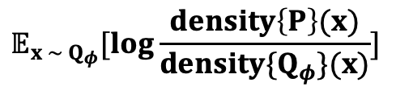
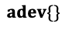

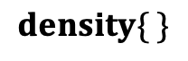
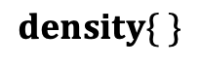
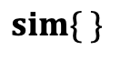
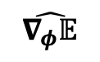
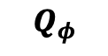
A more modular approach towards automating variational inference (VI)
Generative probabilistic language ($λ_{Gen})$
Differentiable probabilistic language ($λ_{ADEV})$
$$P$$
$$density\{ \}$$
Goal: Maximize objective (ELBO) with respect to $φ$
$$𝔼_{x \sim Q_{φ}}[log\frac{density\left\{P\right\}(x)}{density\{Q_{φ}\}(x)}]$$
$$sim\{ \}$$
$$adev\{\}$$
$$\hat{∇_{φ}𝔼}$$
$$Q_{φ}$$
$$density\{ \}$$
Distributions
Operations on distributions
Objective functions defined
using those operations
Unbiased gradient estimators of those objectives

Slide 7

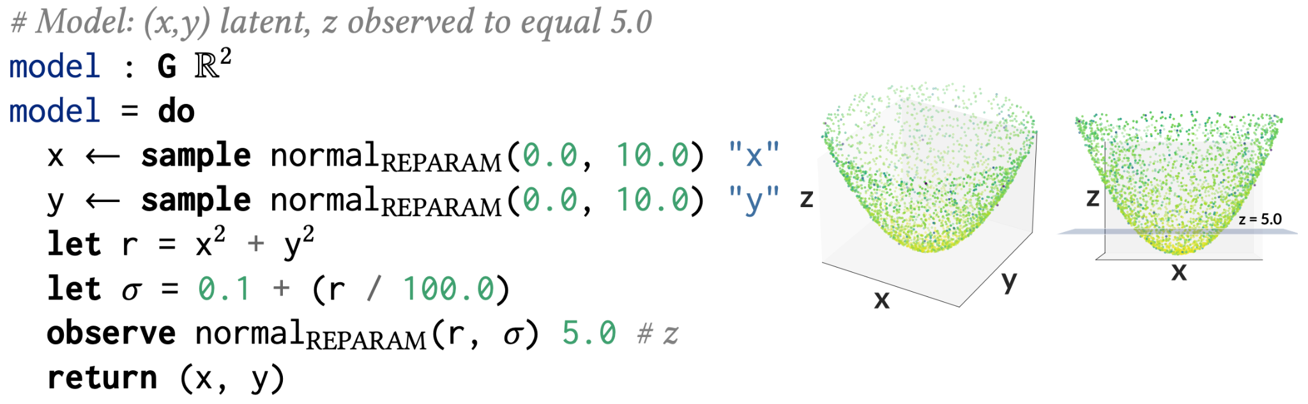
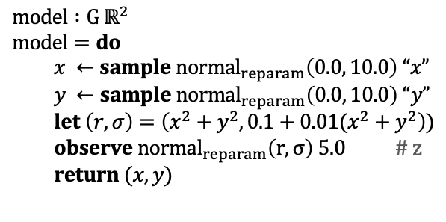
Inference on a noisy cone
Reference posterior (Monte Carlo, large number of samples)
$$model :G ℝ^{2}$$
$$model=do$$
$x ←sample normal_{reparam}\left(0.0, 10.0\right) “x”$
$y ←sample normal_{reparam}\left(0.0, 10.0\right) “y”$
$let \left(r, σ\right)=\left(x^{2}+y^{2}, 0.1+0.01(x^{2}+y^{2}\right))$
$observe normal_{reparam}\left(r, σ\right) 5.0$ # z
$return (x, y)$
Induces
inference
problem
Notes:
For example, one might specify an inference problem like the one in the top pane – we author a distribution which defines a sort of noisy cone.

Slide 8

Inference on a noisy cone
Reference posterior (Monte Carlo, large number of samples)
$$model :G ℝ^{2}$$
$$model=do$$
$x ←sample normal_{reparam}\left(0.0, 10.0\right) “x”$
$y ←sample normal_{reparam}\left(0.0, 10.0\right) “y”$
$let \left(r, σ\right)=\left(x^{2}+y^{2}, 0.1+0.01(x^{2}+y^{2}\right))$
$observe normal_{reparam}\left(r, σ\right) 5.0$ # z
$return (x, y)$
Induces
inference
problem
Notes:
We then condition on z = 5.0, which cuts a plane through the cone using an observe statement. For this problem, we expect the normalized posterior to look something like a ring, with radius approximately square root of 5.
A Monte Carlo method like importance sampling supports the construction of an accurate posterior when using a significant number of samples, even when the prior over the x and y random variables is used as the proposal for the importance sampling program.

Slide 9

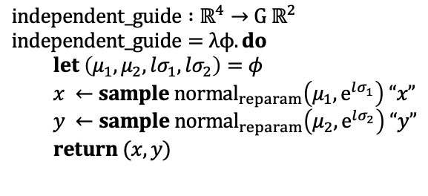
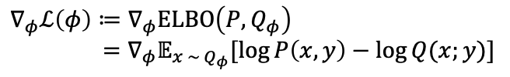
Inference on a noisy cone
Reference posterior (Monte Carlo, large number of samples)
$$model :G ℝ^{2}$$
$$model=do$$
$x ←sample normal_{reparam}\left(0.0, 10.0\right) “x”$
$y ←sample normal_{reparam}\left(0.0, 10.0\right) “y”$
$let \left(r, σ\right)=\left(x^{2}+y^{2}, 0.1+0.01(x^{2}+y^{2}\right))$
$observe normal_{reparam}\left(r, σ\right) 5.0$ # z
$return (x, y)$
Induces
inference
problem
VI:
train $φ$ in a guide program with …
an unbiased gradient estimator that …
$$independent_guide :ℝ^{4}→G ℝ^{2}$$
$$independent_guide=λϕ. do$$
$let \left(μ_{1}, μ_{2},lσ_{1}, lσ_{2}\right)=φ$
$x ←sample normal_{reparam}\left(μ_{1}, e^{lσ_{1}}\right) “x”$
$y ←sample normal_{reparam}\left(μ_{2}, e^{lσ_{2}}\right) “y”$
$return (x, y)$
$∇_{φ}ℒ\left(φ\right)=𝔼[\hat{∇_{φ}]}$
estimates a gradient of some expected value objective
$$∇_{φ}ℒ\left(φ\right)≔∇_{φ}ELBO\left(P, Q_{φ}\right)$$
$={∇_{φ}𝔼}_{x \sim Q_{φ}}[\log{P\left(x, y\right)−\log{Q(x;y)}}]$
Notes:
If we approach this problem with variational inference, the inference problem is converted into an optimization problem.

Slide 10
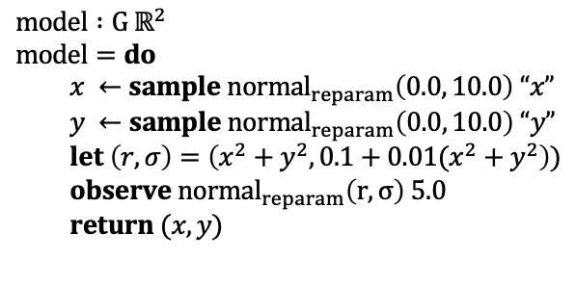
Inference on a noisy cone
Reference posterior (Monte Carlo, large number of samples)
$$model :G ℝ^{2}$$
$$model=do$$
$x ←sample normal_{reparam}\left(0.0, 10.0\right) “x”$
$y ←sample normal_{reparam}\left(0.0, 10.0\right) “y”$
$let \left(r, σ\right)=\left(x^{2}+y^{2}, 0.1+0.01(x^{2}+y^{2}\right))$
$observe normal_{reparam}\left(r, σ\right) 5.0$
$return (x, y)$
Induces
inference
problem
VI:
train $φ$ in a guide program with …
an unbiased gradient estimator that …
$$independent_guide :ℝ^{4}→G ℝ^{2}$$
$$independent_guide=λϕ. do$$
$let \left(μ_{1}, μ_{2},lσ_{1}, lσ_{2}\right)=φ$
$x ←sample normal_{reparam}\left(μ_{1}, e^{lσ_{1}}\right) “x”$
$y ←sample normal_{reparam}\left(μ_{2}, e^{lσ_{2}}\right) “y”$
$return (x, y)$
$∇_{φ}ℒ\left(φ\right)=𝔼[\hat{∇_{φ}]}$
estimates a gradient of some expected value objective
$$∇_{φ}ℒ\left(φ\right)≔∇_{φ}ELBO\left(P, Q_{φ}\right)$$
$={∇_{φ}𝔼}_{x \sim Q_{φ}}[\log{P\left(x, y\right)−\log{Q(x;y)}}]$
Notes:
An expected value objective is used, and this objective typically involves probabilistic computations like sampling and density evaluation, as well as operations like expectation, which amounts to integration.

Slide 11
Inference on a noisy cone
Reference posterior (Monte Carlo, large number of samples)
$$model :G ℝ^{2}$$
$$model=do$$
$x ←sample normal_{reparam}\left(0.0, 10.0\right) “x”$
$y ←sample normal_{reparam}\left(0.0, 10.0\right) “y”$
$let \left(r, σ\right)=\left(x^{2}+y^{2}, 0.1+0.01(x^{2}+y^{2}\right))$
$observe normal_{reparam}\left(r, σ\right) 5.0$
$return (x, y)$
Induces
inference
problem
VI:
train $φ$ in a guide program with …
an unbiased gradient estimator that …
$$independent_guide :ℝ^{4}→G ℝ^{2}$$
$$independent_guide=λϕ. do$$
$let \left(μ_{1}, μ_{2},lσ_{1}, lσ_{2}\right)=φ$
$x ←sample normal_{reparam}\left(μ_{1}, e^{lσ_{1}}\right) “x”$
$y ←sample normal_{reparam}\left(μ_{2}, e^{lσ_{2}}\right) “y”$
$return (x, y)$
$∇_{φ}ℒ\left(φ\right)=𝔼[\hat{∇_{φ}]}$
estimates a gradient of some expected value objective
$$∇_{φ}ℒ\left(φ\right)≔∇_{φ}ELBO\left(P, Q_{φ}\right)$$
$={∇_{φ}𝔼}_{x \sim Q_{φ}}[\log{P\left(x, y\right)−\log{Q(x;y)}}]$
Notes:
Exactly evaluating the gradient of the expectation is often intractable, so unbiased gradient estimators are used instead.

Slide 12

Inference on a noisy cone
Reference posterior (Monte Carlo, large number of samples)
$$model :G ℝ^{2}$$
$$model=do$$
$x ←sample normal_{reparam}\left(0.0, 10.0\right) “x”$
$y ←sample normal_{reparam}\left(0.0, 10.0\right) “y”$
$let \left(r, σ\right)=\left(x^{2}+y^{2}, 0.1+0.01(x^{2}+y^{2}\right))$
$observe normal_{reparam}\left(r, σ\right) 5.0$
$return (x, y)$
Induces
inference
problem
VI:
train $φ$ in a guide program with …
an unbiased gradient estimator that …
$$independent_guide :ℝ^{4}→G ℝ^{2}$$
$$independent_guide=λϕ. do$$
$let \left(μ_{1}, μ_{2},lσ_{1}, lσ_{2}\right)=φ$
$x ←sample normal_{reparam}\left(μ_{1}, e^{lσ_{1}}\right) “x”$
$y ←sample normal_{reparam}\left(μ_{2}, e^{lσ_{2}}\right) “y”$
$return (x, y)$
$∇_{φ}ℒ\left(φ\right)=𝔼[\hat{∇_{φ}]}$
estimates a gradient of some expected value objective
$$∇_{φ}ℒ\left(φ\right)≔∇_{φ}ELBO\left(P, Q_{φ}\right)$$
$={∇_{φ}𝔼}_{x \sim Q_{φ}}[\log{P\left(x, y\right)−\log{Q(x;y)}}]$
Notes:
Given a parametrized guide program and a choice of objective function, PPLs automate the construction of the gradient estimator, which can then be used to train the guide program.

Slide 13


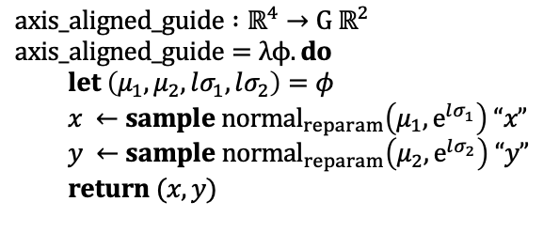
Inference on a noisy cone
Reference posterior (Monte Carlo, large number of samples)
$$model :G ℝ^{2}$$
$$model=do$$
$x ←sample normal_{reparam}\left(0.0, 10.0\right) “x”$
$y ←sample normal_{reparam}\left(0.0, 10.0\right) “y”$
$let \left(r, σ\right)=\left(x^{2}+y^{2}, 0.1+0.01(x^{2}+y^{2}\right))$
$observe normal_{reparam}\left(r, σ\right) 5.0$
$return (x, y)$
Induces
inference
problem
VI:
guide program
Naïve VI
$$axis_aligned_guide :ℝ^{4}→G ℝ^{2}$$
$$axis_aligned_guide=λϕ. do$$
$let \left(μ_{1}, μ_{2},lσ_{1}, lσ_{2}\right)=φ$
$x ←sample normal_{reparam}\left(μ_{1}, e^{lσ_{1}}\right) “x”$
$y ←sample normal_{reparam}\left(μ_{2}, e^{lσ_{2}}\right) “y”$
$return (x, y)$
train $φ$ …
Notes:
Applying variational optimization to this guide program, using a standard objective function called the evidence lower bound, leads to the fit on the right hand side.
This fit is not good, it hugs one side of the posterior because no matter how we place and stretch the guide approximation of axis-aligned normal distributions, our approximation won’t do a good job at capturing the posterior which spreads its mass across the entire ring.
Unable to capture the true posterior, optimization with the ELBO encourages the approximation to tightly cover a mode of the distribution.
Under the ELBO objective, over spreading the uncertainty is harshly penalized.

Slide 14

Importance weighted ELBO
Reference posterior (Monte Carlo, large number of samples)
$$model :G ℝ^{2}$$
$$model=do$$
$x ←sample normal_{reparam}\left(0.0, 10.0\right) “x”$
$y ←sample normal_{reparam}\left(0.0, 10.0\right) “y”$
$let \left(r, σ\right)=\left(x^{2}+y^{2}, 0.1+0.01(x^{2}+y^{2}\right))$
$observe normal_{reparam}\left(r, σ\right) 5.0$
$return (x, y)$
Induces
inference
problem
VI:
guide program
Importance weighted VI
$$axis_aligned_guide :ℝ^{4}→G ℝ^{2}$$
$$axis_aligned_guide=λϕ. do$$
$let \left(μ_{1}, μ_{2},lσ_{1}, lσ_{2}\right)=φ$
$x ←sample normal_{reparam}\left(μ_{1}, e^{lσ_{1}}\right) “x”$
$y ←sample normal_{reparam}\left(μ_{2}, e^{lσ_{2}}\right) “y”$
$return (x, y)$
train $φ$ …

Slide 15

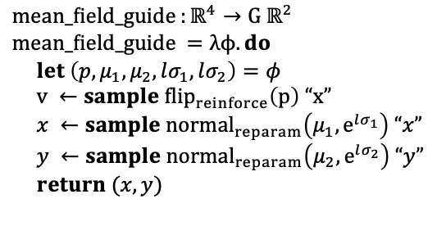
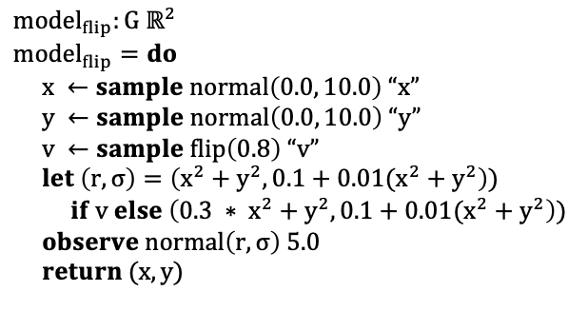
Noisy cone (with discrete choices)
Reference posterior
$${model}_{flip}:G ℝ^{2}$$
$$model_{flip}=do$$
$x ←sample normal\left(0.0, 10.0\right) “x”$
$y ←sample normal\left(0.0, 10.0\right) “y”$
$v ←sample flip\left(0.8\right) “v”$
$let \left(r, σ\right)=\left(x^{2}+y^{2}, 0.1+0.01(x^{2}+y^{2}\right))$
$if v else \left(0.3 ∗ x^{2}+y^{2}, 0.1+0.01(x^{2}+y^{2}\right))$
$observe normal\left(r, σ\right) 5.0$
$return (x, y)$
Flip a coin to decide radius
Induces
inference
problem
VI:
guide program
Naïve VI
$$mean_field_{guide}_{ }:ℝ^{4}→G ℝ^{2}$$
$$mean_field_{guide}_{ }=λϕ. do$$
$let \left({p, μ}_{1}, μ_{2},lσ_{1}, lσ_{2}\right)=φ$
$v ←sample {flip}_{reinforce}\left(p\right) “x”$
$x ←sample normal_{reparam}\left(μ_{1}, e^{lσ_{1}}\right) “x”$
$y ←sample normal_{reparam}\left(μ_{2}, e^{lσ_{2}}\right) “y”$
$return (x, y)$
train $φ$ …
Notes:
Simple modifications can lead to even more difficult inference problems. For instance, adding a flip random choice to choose between two circle equations leads to a posterior which looks like a pair of nested circles.
Standard VI with a mean field variational approximation is hopeless on this problem.

Slide 16
Our approach: new automation for variational inference (VI)
Generative probabilistic language ($λ_{Gen})$
Differentiable probabilistic language ($λ_{ADEV})$
$$P$$
$$density\{ \}$$
Goal: Maximize objective (ELBO) with respect to $φ$
$$𝔼_{x \sim Q_{φ}}[log\frac{density\left\{P\right\}(x)}{density\{Q_{φ}\}(x)}]$$
$$sim\{ \}$$
$$adev\{\}$$
$$\hat{∇_{φ}𝔼}$$
$$Q_{φ}$$
$$density\{ \}$$
Distributions
Operations on distributions
Objective functions defined
using those operations
Unbiased gradient estimators of those objectives
Notes:
So how does our approach support iterative design of variational inference algorithms.

Slide 17
Our approach: new automation for variational inference (VI)
Generative probabilistic language ($λ_{Gen})$
Differentiable probabilistic language ($λ_{ADEV})$
$$P$$
$$density\{ \}$$
Goal: Maximize objective (ELBO) with respect to $φ$
$$𝔼_{x \sim Q_{φ}}[log\frac{density\left\{P\right\}(x)}{density\{Q_{φ}\}(x)}]$$
$$sim\{ \}$$
$$adev\{\}$$
$$\hat{∇_{φ}𝔼}$$
$$Q_{φ}$$
$$density\{ \}$$
Distributions
Operations on distributions
Objective functions defined
using those operations
Unbiased gradient estimators of those objectives
Notes:
We separate the concerns of variational inference into two languages – our first language is a generative probabilistic language, with support for probabilistic program traces, stochastic control flow, and expressive modeling constructs like marginal.
Both of the guides that we saw before can be expressed in this language.

Slide 18
Our approach: new automation for variational inference (VI)
Generative probabilistic language ($λ_{Gen})$
Differentiable probabilistic language ($λ_{ADEV})$
$$P$$
$$density\{ \}$$
Goal: Maximize objective (ELBO) with respect to $φ$
$$𝔼_{x \sim Q_{φ}}[log\frac{density\left\{P\right\}(x)}{density\{Q_{φ}\}(x)}]$$
$$sim\{ \}$$
$$adev\{\}$$
$$\hat{∇_{φ}𝔼}$$
$$Q_{φ}$$
$$density\{ \}$$
Distributions
Operations on distributions
Objective functions defined
using those operations
Unbiased gradient estimators of those objectives
Notes:
Our second language is a differentiable probabilistic language – it supports automation for constructing unbiased gradient estimators from programs which denote expected value loss functions.
Given a loss estimator program, this language provides an AD transform which construct an unbiased gradient estimator.
All of the objectives we just saw can be expressed as loss estimator programs in this language.
In addition, this language also supports the annotation of samplers in loss estimator programs with gradient estimation strategies.
The AD transformation uses these annotations to construct an unbiased gradient estimator.

Slide 19
Our approach: new automation for variational inference (VI)
Generative probabilistic language ($λ_{Gen})$
Differentiable probabilistic language ($λ_{ADEV})$
$$P$$
$$density\{ \}$$
Goal: Maximize objective (ELBO) with respect to $φ$
$$𝔼_{x \sim Q_{φ}}[log\frac{density\left\{P\right\}(x)}{density\{Q_{φ}\}(x)}]$$
$$sim\{ \}$$
$$adev\{\}$$
$$\hat{∇_{φ}𝔼}$$
$$Q_{φ}$$
$$density\{ \}$$
Distributions
Operations on distributions
Objective functions defined
using those operations
Unbiased gradient estimators of those objectives

Slide 20
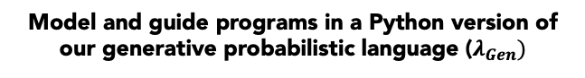
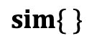
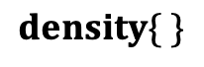
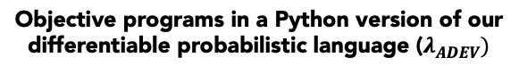
Unrolling our automation (all ingredients)
Model and guide programs in a Python version of our generative probabilistic language ($λ_{Gen})$
Objective programs in a Python version of our differentiable probabilistic language ($λ_{ADEV})$
$$density\{ \}$$
$$sim\{ \}$$
Notes:
Now, I want to show you how our automation works.
To start, a user writes two programs, a model program which defines a posterior problem, and a parametrized guide program – which defines a family of variational approximations.
The guide program features gradient annotations, here flip_reinforce and normal_reparam. Under our AD automation, these annotations enforce that the REINFORCE estimator will be used for the flip random choice, and reparametrization will be used for the normal choice. We’ll return to these in a moment, when I show how our AD transformation works.
Now, given these two programs – the user utilizes an objective function. Objective functions are represented by programs which can make use of sampling and density evaluation through the sim and density interfaces on the model and guide programs.
On the right, I’m showing the ELBO objective, which is one of the objectives we used on our earlier example.

Slide 21
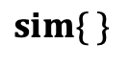
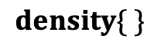
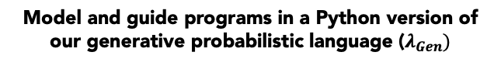
Unrolling our automation ($density\{ \}$ & $sim\{ \}$)
Model and guide programs in a Python version of our generative probabilistic language ($λ_{Gen})$
$$density\{ \}$$
ADEV sampler
ADEV sampler
$$sim\{ \}$$
Notes:
Let’s first expand the definitions of density and sim applied to our programs.

Slide 22
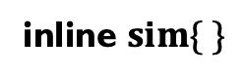
Unrolling our automation (inlining)
inline $sim\{ \}$
Notes:
Now, with density and sim defined, let’s return to our ELBO program.
Here, I’m going to inline the definition of sim applied to our guide program, but keep density encapsulated, for simplicity.
Note that, in this case, density doesn’t involve any sampling, so our AD automation doesn’t do anything too interesting there.

Slide 23
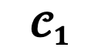
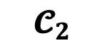
Unrolling our automation (inlining)
$$𝓒_{1}$$
$$𝓒_{2}$$
Notes:
Now, I’m showing how our AD transformation operates. I’ve cut the program up into pieces, each piece is a continuation of the computation after a sampling statement.
Our AD transformation propagates dual numbers, just like in normal forward mode, but also stops at each sampling statement, and hands the continuation off to code which implements the gradient estimation strategy associated with the sampler.
This happens twice in our program, for each random choice in the guide program.

Slide 24
Notes:
After handling both samplers, the resulting program on the right hand side is the forward mode version of our original objective program.
Take the dual component returns the desired derivative.

Slide 25
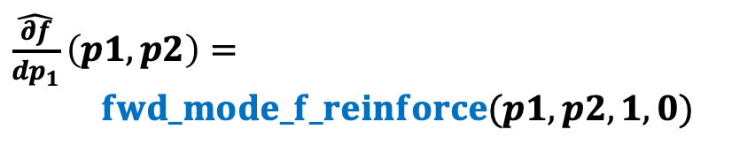

Reverse mode vs. forward mode estimators
For forward mode, full gradient computation goes like O(N) for N input dims
TODO SCALING CURVE
Example: (# of params) = 2
$\hat{\frac{∂f}{dp_{1}}}\left(p1, p2\right)=$
$fwd_mode_f_reinforce(p1, p2, 1, 0)$
$\hat{\frac{∂f}{dp_{2}}}\left(p1, p2\right)=$
$fwd_mode_f_reinforce(p1, p2, 0, 1)$
Requires 2 invocations, because forward mode computes directional derivatives.
Notes:
For the purposes of this discussion, the meaningful difference between these two modes of AD is that, for forward mode to compute an estimate of the gradient vector for a program with two parameters p1 and p2, we’d need to invoke the derivative estimator program twice.
This is the well-known scaling law for forward mode: for scalar functions, the number of invocations required to compute full gradient vectors goes like N, where N is the number of input dimensions, and the same computational scaling applies to forward mode ADEV’s unbiased gradient estimator programs.

Slide 26

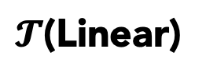
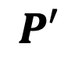
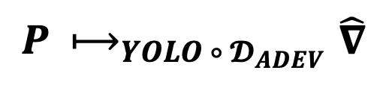
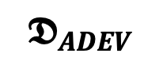





automating a reverse mode ADEV estimator
YOLO (Radul et al, 2023 POPL)
Reverse mode ADEV via YOLO (Becker & Huot et al, 2024 POPL)
$$𝓤$$
Nonlinear
$$P$$
$$P′$$
$$\hat{∇}$$
$$𝕯_{ADEV}$$
$$𝓤$$
Linear
$𝓣$(Linear)
$$𝓣$$
reverse mode ADEV via YOLO
Under:
$$P ⟼_{{YOLO ∘ 𝓓}_{ADEV}}\hat{∇}$$
Get:
$${∇_{θ}𝔼}_{x \sim ⟦P⟧\left(θ\right)}\left[x\right]=𝔼_{x \sim ⟦\hat{∇}⟧(θ)}[x]$$
Notes:
As part of our work, we automated the construction of a reverse mode implementation of ADEV by using program transformations from a paper called You Only Linearize Once (or YOLO).
A reverse mode allows our approach to scale to problems involving large numbers of parameters, like settings where we’re interested in combining probabilistic programs with neural networks.
The key insight is that YOLO’s technique, which is designed to take deterministic forward mode computations to reverse mode ones, can be extended to the setting of ADEV.
The intuition is that many of the samplers used by ADEV to construct unbiased forward mode estimator programs don’t depend on forward mode tangent values, meaning we can safely embed the sampling primitives into the nonlinear fragment of YOLO, and we don’t have to modify the transformations.

Slide 27
Notes:
So that’s how our approach works,

Slide 28
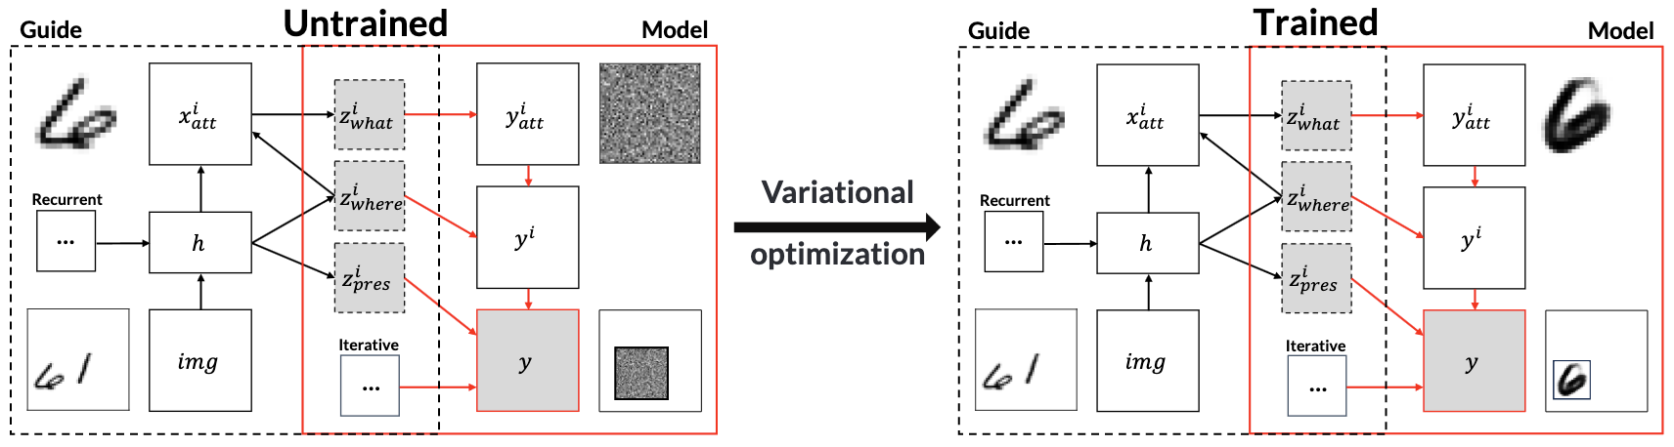
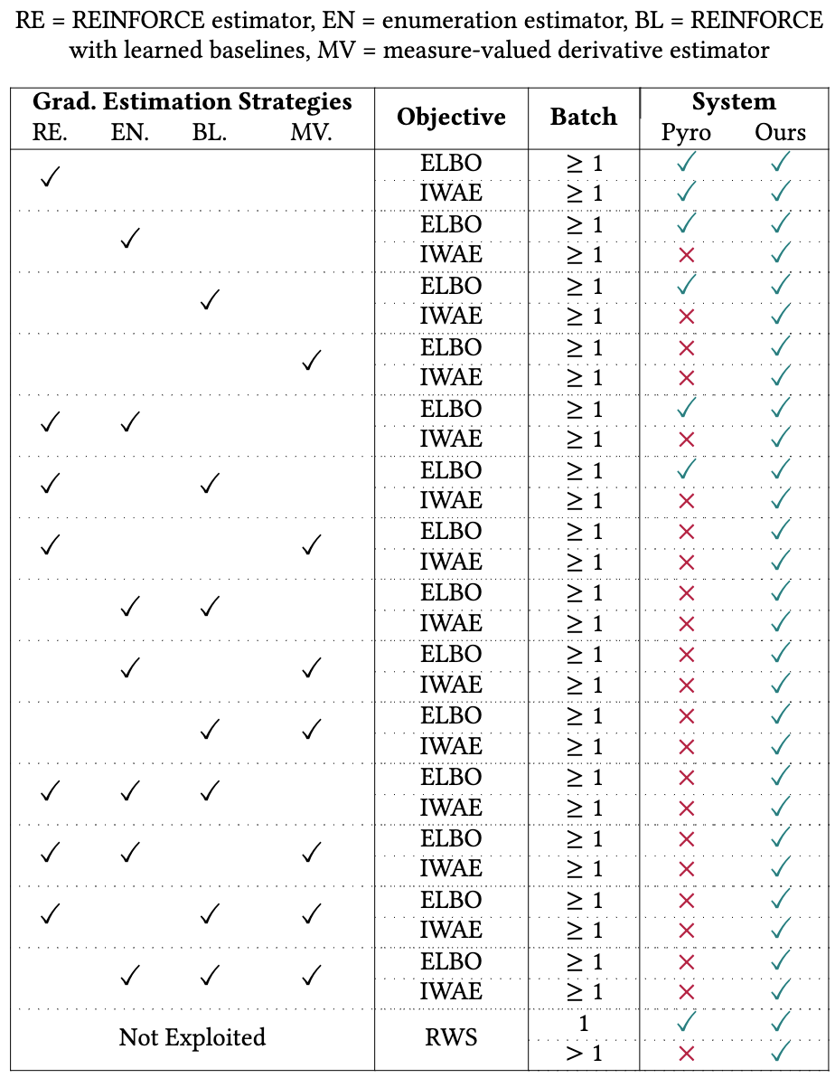
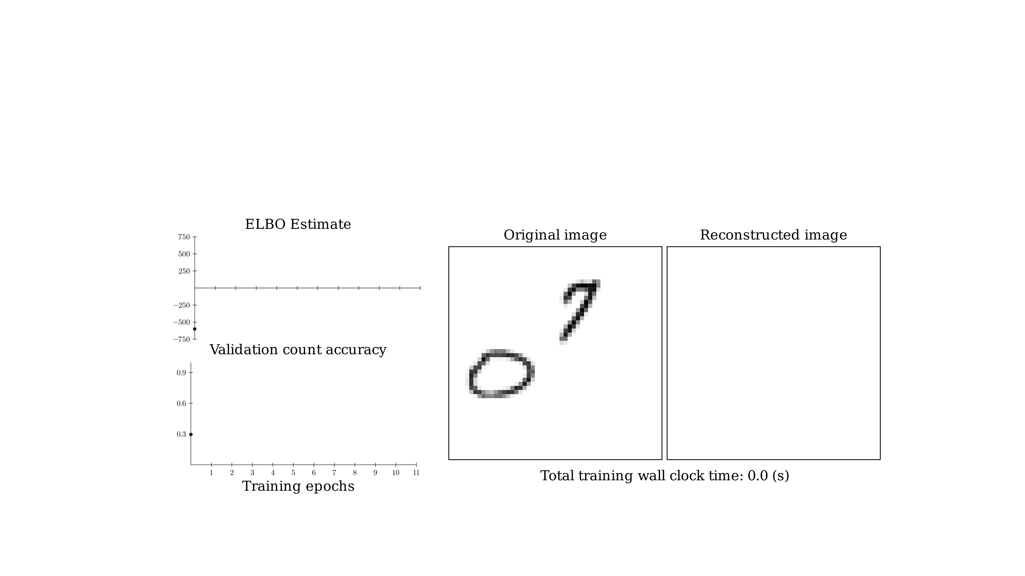

Our system gives you access to a combinatorial space of unbiased gradient estimators.
Attend, infer, repeat (Eslami et al, 2016)
Supported?
REINFORCE for discrete samples leads to poor training convergence.
MVD is a better gradient estimator for discrete samplers –
using it instead of REINFORCE drastically improves convergence.
Not previously automated for VI
Notes:
One implication of our design is that we expose a combinatorial space of unbiased gradient estimators – users are allowed to change their objective functions, as well as the estimator strategies which are used inside of their model and guide programs.
In our system, these design degrees of freedom do not interact monolithically…
In this talk, we’ve hoped to convince you that the process of designing good variational inference algorithms requires iterating over this space.
We investigated this claim on variational inference algorithms for a deep generative model called Attend, infer, repeat, shown top right.
This is a model for multi-object images. It defines a distribution over the placement and content of objects in the image. In variational inference, a guide program must guess the placement…

Slide 29

Open-source artifact to accompany Probabilistic programming with programmable variational inference
(Becker & Lew et al, 2024)
https://doi.org/10.5281/zenodo.10938970
Notes:
Finally, there’s an open source artifact with a version of `genjax.vi` to accompany our paper, and we’re expecting to release the full GenJAX probabilistic programming system publicly sometime later this year.

Slide 30

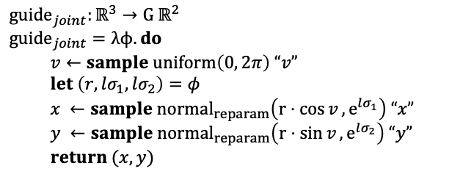
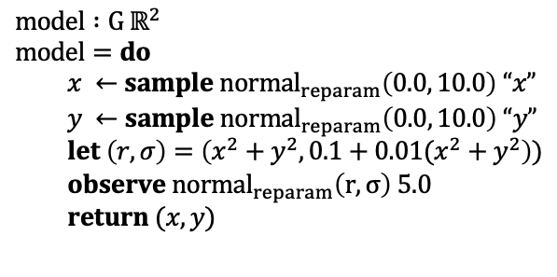
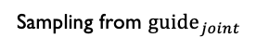
Inference on a noisy cone
$$model :G ℝ^{2}$$
$$model=do$$
$x ←sample normal_{reparam}\left(0.0, 10.0\right) “x”$
$y ←sample normal_{reparam}\left(0.0, 10.0\right) “y”$
$let \left(r, σ\right)=\left(x^{2}+y^{2}, 0.1+0.01(x^{2}+y^{2}\right))$
$observe normal_{reparam}\left(r, σ\right) 5.0$
$return (x, y)$
VI:
Sampling from ${guide}_{joint}$
$${guide}_{joint}:ℝ^{3}→G ℝ^{2}$$
$${guide}_{joint}=λϕ. do$$
$v←sample uniform\left(0, 2π\right) “v”$
$let \left(r,lσ_{1}, lσ_{2}\right)=φ$
$x ←sample normal_{reparam}\left(r⋅\cos{v},e^{lσ_{1}}\right) “x”$
$y ←sample normal_{reparam}\left(r⋅\sin{v}, e^{lσ_{2}}\right) “y”$
$return (x, y)$
Aux. random
choice
Notes:
This is a much better guide program, but because there’s an auxiliary random choice, we can’t use the standard ELBO -- if we tried to apply the definition we’d get an extra term, preventing our optimization from behaving in the same way.

Slide 31
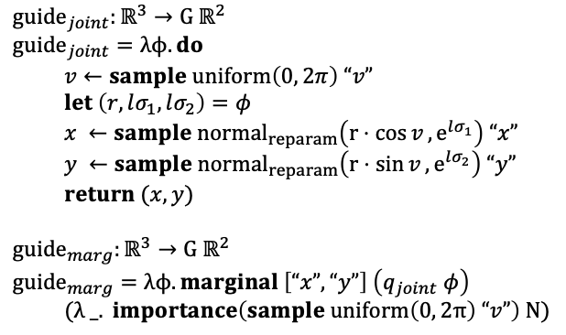
Inference on a noisy cone
$$model :G ℝ^{2}$$
$$model=do$$
$x ←sample normal_{reparam}\left(0.0, 10.0\right) “x”$
$y ←sample normal_{reparam}\left(0.0, 10.0\right) “y”$
$let \left(r, σ\right)=\left(x^{2}+y^{2}, 0.1+0.01(x^{2}+y^{2}\right))$
$observe normal_{reparam}\left(r, σ\right) 5.0$
$return (x, y)$
VI:
$${guide}_{joint}:ℝ^{3}→G ℝ^{2}$$
$${guide}_{joint}=λϕ. do$$
$v←sample uniform\left(0, 2π\right) “v”$
$let \left(r,lσ_{1}, lσ_{2}\right)=φ$
$x ←sample normal_{reparam}\left(r⋅\cos{v},e^{lσ_{1}}\right) “x”$
$y ←sample normal_{reparam}\left(r⋅\sin{v}, e^{lσ_{2}}\right) “y”$
$return (x, y)$
$${guide}_{marg}:ℝ^{3}→G ℝ^{2}$$
$${guide}_{marg}=λϕ. marginal \left[“x”, “y”\right] \left(q_{joint} φ\right)$$
$(λ _. importance\left(sample uniform\left(0, 2π\right) “v”\right) N)$
Auxiliary variational inference
(Agakov & Barber, 2004; Ranganath et al, 2016; Maaløe et al, 2016)
Notes:
What we can do is marginalize the joint guide and use the marginal as the guide. Because marginalization introduces integration, which we can’t do exactly, in places where our objective expects us to evaluation the density of the guide, we’ll instead use unbiased estimators of the density.
This is equivalent to a class of algorithms called auxiliary or hierarchical variational inference.

Slide 32
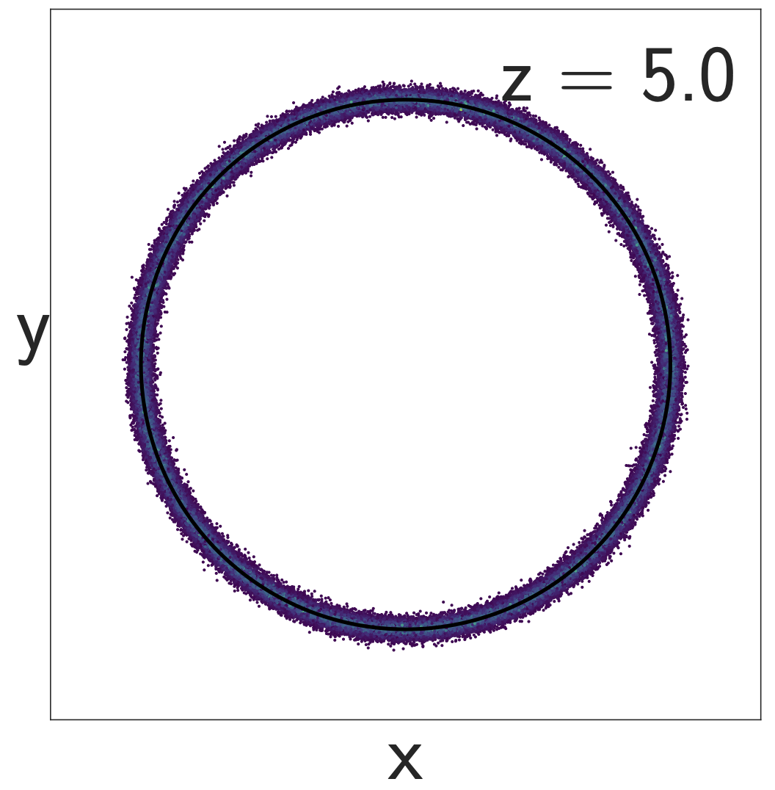
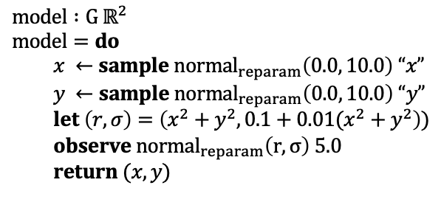
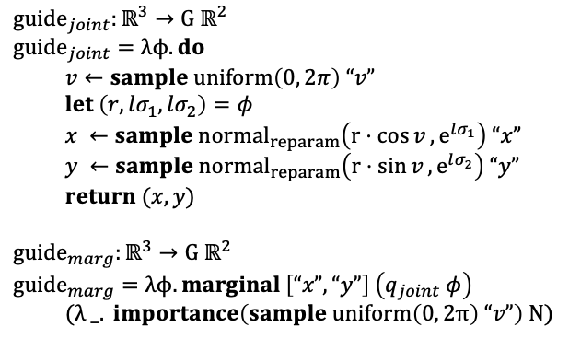

Inference on a noisy cone
Monte Carlo methods
$$model :G ℝ^{2}$$
$$model=do$$
$x ←sample normal_{reparam}\left(0.0, 10.0\right) “x”$
$y ←sample normal_{reparam}\left(0.0, 10.0\right) “y”$
$let \left(r, σ\right)=\left(x^{2}+y^{2}, 0.1+0.01(x^{2}+y^{2}\right))$
$observe normal_{reparam}\left(r, σ\right) 5.0$
$return (x, y)$
VI:
$${guide}_{joint}:ℝ^{3}→G ℝ^{2}$$
$${guide}_{joint}=λϕ. do$$
$v←sample uniform\left(0, 2π\right) “v”$
$let \left(r,lσ_{1}, lσ_{2}\right)=φ$
$x ←sample normal_{reparam}\left(r⋅\cos{v},e^{lσ_{1}}\right) “x”$
$y ←sample normal_{reparam}\left(r⋅\sin{v}, e^{lσ_{2}}\right) “y”$
$return (x, y)$
$${guide}_{marg}:ℝ^{3}→G ℝ^{2}$$
$${guide}_{marg}=λϕ. marginal \left[“x”, “y”\right] \left(q_{joint} φ\right)$$
$(λ _. importance\left(sample uniform\left(0, 2π\right) “v”\right) N)$
Auxiliary variable VI
train $φ$ …
Notes:
Training a guide using these methods leads to an excellent fit, which correctly matches the ring-like pattern of the posterior that we expected from the naive Monte Carlo algorithm with lots of samples.

Slide 33
Gen
(without our extension)
Pyro
Offered
Not offered
Naïve VI
Auxiliary variable VI
Notes:
But there’s an automation problem with this strategy – it’s not supported natively by PPLs. In theory, one can express the objective where we use a marginal distribution – but the reality is that doing so requires significant expertise.

Slide 34






Variational inference today – processes for learning probability distributions
Learning generative models from data
Learning posterior approximations
Generative image models
Re-usable posteriors in generic probabilistic programs
Diffusion models (Sohl-Dickstein et al, 2015, Yang & Ermon, 2019)
Multi-object image segmentation and generation
Attend, infer, repeat (Eslami et al, 2016)
Inference compilation (Tuan Anh Le et al, 2016)
Posteriors over discrete latent structure with neural models
Fine-tuning LLMs
Distributions to construct complex objects
(LoRA, Hu et al, 2021)
GFlowNets (Bengio et al, 2021)
Structured variational autoencoders (Johnson et al, 2016)
Notes:
And variational inference today features a massive wealth of applications, concerned with both fitting complex probability distributions to data, and providing approximate solutions to posterior problems.
On this slide, I’m showing a selection of applications which rely on variational subroutines to learn distributions.
In diffusion models, for instance, where the learning process involves learning layers of noising and denoising distributions to match a dataset, or in fine tuning LLMs, where we want the distribution of a sampler to match distributional properties of a private knowledge base.
Variational inference has grown into a set of techniques which AI researchers regularly draw upon when designing new probability distributions.

Slide 35
Why don’t these applications use PPLs?
Learning generative models from data
Learning posterior approximations
Generative image models
Re-usable posteriors in generic probabilistic programs
Diffusion models (Sohl-Dickstein et al, 2015, Yang & Ermon, 2019)
Multi-object image segmentation and generation
Attend, infer, repeat (Eslami et al, 2016)
Inference compilation (Tuan Anh Le et al, 2016)
Posteriors over discrete latent structure with neural models
Fine-tuning LLMs
Distributions to construct complex objects
(LoRA, Hu et al, 2021)
GFlowNets (Bengio et al, 2021)
Structured variational autoencoders (Johnson et al, 2016)
Notes:
Now, if all of these techniques deal fundamentally with operations on probability distributions, we can ask the question: what’s missing from the current design of PPLs that prevent these processes from benefiting from PPL automation?

Slide 36
Why don’t these applications use PPLs?
Generative image models
Re-usable posteriors in generic probabilistic programs
Diffusion models (Sohl-Dickstein et al, 2015, Yang & Ermon, 2019)
Multi-object image segmentation and generation
Attend, infer, repeat (Eslami et al, 2016)
Inference compilation (Tuan Anh Le et al, 2016)
Posteriors over discrete latent structure with neural models
Fine-tuning LLMs
Distributions to construct complex objects
(LoRA, Hu et al, 2021)
GFlowNets (Bengio et al, 2021)
Structured variational autoencoders (Johnson et al, 2016)
The answer: lack of expressive automation for gradient estimation.
Notes:
The answer can be boiled down to the fact that current PPLs are not well-designed to automate computations which involve gradient estimation.

Slide 37


Gen
(without our extension)
Pyro
menu-based approach
(no substitutions!)
If ELBO or IWELBO, then:
Model $P$ must have an exact density
Guide $Q$ can’t use auxiliary variables and must support exact density.
Any discrete sampling must use REINFORCE or enumeration.
Choose objective function:
ELBO piperade
Wake-sleep ceviche
IWELBO au vin
Amortized EUBO foie gras
HVI n. a.
$$\hat{∇_{φ}𝔼}$$
If Wake-sleep, then:
Same restrictions as ELBO / IWELBO.
Can’t batch more than 1 particle.
Notes:
And that’s because systems like Gen without our extension or Pyro approach variational inference from a menu-based perspective –
Menu-based here means that the authors of the system expose a set of loss functions with gradient estimator automation with limited means of extension or customization.
Systems which take this approach automate a lot of useful processes for sure! But if a user wishes to use the system in a way which is not supported by the authors, they typically need to become as competent as the authors are to extend the core system.
This often leads to tension for users – like in the problem I just showed, where exploring the space of VI solutions would require that users potentially implement a new objective function.
But this also goes beyond just objective functions – even at the level of the automation provided to produce gradient estimators, there are many useful strategies for gradient estimation which Gen and Pyro do not support.
If a user wished to add these to these systems, it’s not clear where they would start.

Slide 38







Requirements for variational inference
$$P$$
$$density\{ \}$$
Goal: Maximize objective (ELBO) with respect to $φ$
$$𝔼_{x \sim Q_{φ}}[log\frac{density\left\{P\right\}(x)}{density\{Q_{φ}\}(x)}]$$
AD
automation
$$sim\{ \}$$
$$\hat{∇_{φ}𝔼}$$
$$Q_{φ}$$
$$density\{ \}$$
Distributions
Operations on distributions
Expected value objective functions defined using those operations
Unbiased gradient estimators for those objectives
Notes:
Backing up, we can take note of the requirements for variational inference, the ingredients which systems that automate VI need to provide.
These are things like distributions and operations on distributions, including sampling and density computations.
These operations are used to express VI objective functions, here I’m showing the ELBO objective function from before.
Finally, we expect AD automation that converts the specification of a VI optimization problem into an unbiased gradient estimator – to be used in training.
Gradient estimators are used because, again, exactly evaluating most expectations is intractable.

Slide 39




Research demotivated by the complexity of gradient estimation
Inference compilation (Tuan Anh Le et al, 2016)
must change loss to account for density estimation of $q$
Change $q$ to be SMC as a proposal
$$ℒ\left(φ\right)≔ 𝔼_{p\left(y\right)}\left[D_{KL}\left(p\left(x \right|y\right)\right| q(x;y, φ))]$$
implies that gradient estimators must be used…
Poor automation, so isn’t explored.
Structured variational autoencoders (Johnson et al, 2016)
TODO
Change $p$ to be a probabilistic program over a grammar
Current PPLs are restricted when it comes to gradient estimation.
Notes:
TODO:
And lack of automation in this area has serious consequences for research – changing the inference assumptions in the first paper, or changing the model assumptions in the second paper would imply that the authors of these papers would have to rewrite their entire learning processes, deriving new gradient estimators by hand.
That means iterate on the research is hard -- this is why automation is so fundamental to research.
In other words, questions like “what about inference compilation, where Q is actually an SMC probabilistic program” or “what about structured VAEs, where the model is a probabilistic program over a grammar, and not just a graphical model with exponential family structure” were simply too complicated to understand without natively probabilistic gradient automation.

Slide 40








Requirements for variational inference
$$P$$
$$density\{ \}$$
Goal: Maximize objective (ELBO) with respect to $φ$
$$𝔼_{x \sim Q_{φ}}[log\frac{density\left\{P\right\}(x)}{density\{Q_{φ}\}(x)}]$$
AD
automation
$$sim\{ \}$$
$$\hat{∇_{φ}𝔼}$$
$$Q_{φ}$$
$$density\{ \}$$
Distributions
Operations on distributions
Expected value objective functions defined using those operations
Unbiased gradient estimators for those objectives
Our approach: new automation for variational inference (VI)
Generative probabilistic language
Differentiable probabilistic language
$$P$$
$$density\{ \}$$
Goal: Maximize objective (ELBO) with respect to $φ$
$$𝔼_{x \sim Q_{φ}}[log\frac{density\left\{P\right\}(x)}{density\{Q_{φ}\}(x)}]$$
$$sim\{ \}$$
$$adev\{\}$$
$$\hat{∇_{φ}𝔼}$$
$$Q_{φ}$$
$$density\{ \}$$
Distributions
Operations on distributions
Objective functions defined
using those operations
Unbiased gradient estimators of those objectives
Notes:
In this talk, I’m going to present a new approach towards VI.
Our approach is based on 2 languages which provide a clean separation of the requirements of variational inference.
The target language on the right hand side is a differentiable probabilistic language which supports an AD algorithm that constructs unbiased gradient estimators for expected value objective functions. This language also supports extensive configuration of the estimators – it exposes levers that one can use to customize the properties of the resulting estimators, between lower variance but potentially slower estimators, to faster but noisier ones.
It also supports estimators which have never been used for variational inference, like measure valued derivative estimators for discrete random choices.
Our source language on the left hand side is an expressive probabilistic programming language which models systems like Gen or Pyro. This language allows users to author distributions as probabilistic programs, to be used by users in variational inference problems.
This language also supports 2 transformations – a sampling transformation called sim, and a density evaluation transformation called density. These transformations lower terms in our source language into terms in our target language.
Users who wish to author entirely new variational inference objectives can use these transformations to concisely express new objective programs.

Slide 41







Our approach: new automation for variational inference (VI)
Generative probabilistic language
Differentiable probabilistic language
$$P$$
$$density\{ \}$$
Goal: Maximize objective (ELBO) with respect to $φ$
$$𝔼_{x \sim Q_{φ}}[log\frac{density\left\{P\right\}(x)}{density\{Q_{φ}\}(x)}]$$
$$adev\{\}$$
$$sim\{ \}$$
$$\hat{∇_{φ}𝔼}$$
$$Q_{φ}$$
$$density\{ \}$$
Distributions
Operations on distributions
Objective functions defined
using those operations
Unbiased gradient estimators of those objectives
Notes:
I’m going to start by talking about the differentiable probabilistic language.

Slide 42











Our approach: new automation for variational inference (VI)
Generative probabilistic language
Differentiable probabilistic language
$$P$$
$$density\{ \}$$
Goal: Maximize objective (ELBO) with respect to $φ$
$$𝔼_{x \sim Q_{φ}}[log\frac{density\left\{P\right\}(x)}{density\{Q_{φ}\}(x)}]$$
$$adev\{\}$$
$$sim\{ \}$$
$$\hat{∇_{φ}𝔼}$$
$$Q_{φ}$$
$$density\{ \}$$
Distributions
Operations on distributions
Objective functions defined
using those operations
Unbiased gradient estimators of those objectives
Our impl: genjax.vi
Generative PPL for authoring distributions
with configurable gradient strategies
Differentiable PPL for expressing loss programs
🌟 GPU accelerated
🌟 Reverse mode
🌟 Natively integrates with
JAX AD
Automation to express significantly more gradient estimators than Gen (without our extension) or Pyro, orders of magnitude faster.
Notes:
In this talk, I’m going to present an approach towards resolving these issues.
In the top pane, I’m showing the typical ingredients of a variational inference problem – distributions P and Q, some learnable parameters phi which parametrizes Q, and an objective function, here it is an expectation over Q, where the function inside the expectation involves operations on P and Q, like evaluating their densities.
Solving a variational inference problem involves constructing a gradient estimator for this objective, and using it to tweak the parameters of Q, and often also P, though I’m not showing it in this example.
The punchline of this talk is that we’ve developed a new approach to variational inference which is significantly more expressive than the automation available in current PPLs, and we’ve produced an implementation of our approach in a GPU accelerated extension to Gen called genjax.vi
Our implementation is convenient to use to automate the workflows involved in variational inference problems, a step towards automating complex VI problems like the ones I mentioned at the beginning of this talk.

Slide 43
Example: solving inference on a noisy cone
Notes:
To start, let’s see how VI works on an example -- in probabilistic programming, we represent probability distributions using programs.
Common operations on probability distributions include things like sampling, or computing the density of a sample on the support of the distribution, or when the distribution admits a joint decomposition -- conditioning the distribution on observed data.

Slide 44

Example: solving inference on a noisy cone
Condition on $z=5.0$
Density of an unnormalized measure
Notes:
Computing with conditional distributions is common in Bayesian inference.
One way which conditional problems are represented in probabilistic programming languages is through observe statements.
To compute density in the box shown bottom right, we evaluate and form the product of the densities of the random samples at x and y and then, at the observe statement, we product the density of the normal distribution evaluated at 5.0.
This is equivalent to the joint density over x y and z, if we fixed z to be 5.0

Slide 45

Example: solving inference on a noisy cone
Approximate posterior constructed using sampling importance resampling with
N = 1000 particles
(Variational inference) Find a distribution $Q$ which is close to the normalized version of model.
Notes:
Using observe in this way induces a posterior inference problem – and the goal of inference is to compute with the normalized version of this distribution.
There are various approaches to solving this problem – importance sampling, for instance, can produce a sampler which approximates a sampler for the posterior.
As I mentioned on the first slide, variational inference treats the problem as an optimization problem.

Slide 46
Notes:
TODO:
Here, I’m showing an animation of VI optimization for 2 different guides, and 2 different objective functions.
The behavior of the final learned approximation drastically depends on the expressivity of the guide, the loss function, and

Slide 47

AD for VI objectives
Objectives over spaces of distributions
Our objective in math
$$ELBO\left(P, Q_{φ}\right)=𝔼_{x \sim Q_{φ}}\left[\log{P(x, y)}−\log{Q_{φ}(x;y)}\right]$$
$=\log{P(z) −KL\left(Q, \tilde{P}\right)}$
Evidence
KL divergence
Notes:
Now that we understand what variational inference is about, we can dig deeper into the automation.
There are many different objective functions used in variational inference, but a standard starting point is an objective called the evidence lower bound or ELBO for short – the ELBO is the gap between the normalization constant for the inference problem, here called the evidence, and a KL divergence between Q and the posterior – the posterior I’m calling P tilde.
Therefore, if you maximize the ELBO, with the evidence a constant, you are minimizing the KL.
Minimizing the KL is beneficial, because when the KL is 0, the two distributions are equal almost everywhere – so the value of KL is used as one notion of distance between distributions.

Slide 48
AD for VI objectives
Objectives over spaces of distributions
Our objective in math
$$ELBO\left(P, Q_{φ}\right)=𝔼_{x \sim Q_{φ}}\left[\log{P(x, y)}−\log{Q_{φ}(x;y)}\right]$$
$=\log{P(z) −KL\left(Q, \tilde{P}\right)}$
Evidence
KL divergence
So, we just write this as a program, and use AD … right?
Notes:
So – this begs the question: we have an objective function – can we use AD to get a gradient, and then use gradient descent?

Slide 49






A new compositional approach to variational inference
$λ_{Gen}$ $(Becker \& Lew, et al, 2024)$
$$A∇𝔼V (Lew \& Huot, et al, 2023)$$
An expressive higher-order PPL with traces.
Distribution primitives equipped with gradient strategies ($normal_{REINFORCE}$, $flip_{MVD}$, $beta_{IMPLICIT}$)
$sim\left\{ \right\}$ & $density\{ \}$: transformations implementing sampling and density computations compatible with ADEV.
Language for $𝔼_{⟦Q⟧(θ)}\left[…\right]$ losses
Sampling primitives equipped with gradient strategies (REINFORCE, MVD, ENUM)
$𝕯\left\{ \right\}$: a modular extension to forward mode AD
$$Reverse mode A∇𝔼V$$
$$(Becker \& Huot, et al, 2024)$$
Notes:
Well, it turns out it is not so easy, and I will be long winded about why in a moment, I want to show where we’re going to end up.
Our full approach is based on a separation of the concerns of variational inference into two languages, with AD automation provided by a new AD algorithm which natively works with expectations and sampling.

Slide 50

A new compositional approach to variational inference
$λ_{Gen}$ $(Becker \& Lew, et al, 2024)$
$$A∇𝔼V (Lew \& Huot, et al, 2023)$$
Language for $𝔼_{⟦Q⟧(θ)}\left[…\right]$ losses
Distribution primitives equipped with gradient strategies (REINFORCE, MVD, ENUM)
$sim\left\{ \right\}$ & $density\{ \}$: transformations implementing sampling and density computations
Language for $𝔼_{⟦Q⟧(θ)}\left[…\right]$ losses
Sampling primitives equipped with gradient strategies (REINFORCE, MVD, ENUM)
$𝕯\left\{ \right\}$: a modular extension to forward mode AD
$$Reverse mode A∇𝔼V$$
$$(Becker \& Huot, et al, 2024)$$
Notes:
One immediate question might be – why is a new form of AD required?

Slide 51






Our objective in math
$$ELBO\left(P, Q_{φ}\right)=𝔼_{x \sim Q_{φ}}\left[\log{P(x, y)}−\log{Q_{φ}(x;y)}\right]$$
What ( , , ) do automate
$$P ∷ ℝ^{N}→ ℝ$$
$$∇P ∷ ℝ^{N}→ ℝ^{N}$$
$$∇$$
Notes:
But there’s a problem with using conventional AD systems for this problem:
If you’re a practitioner, you might download one of these systems and begin to write down the ELBO… but the problem is that the ELBO involves these symbols like E and tilde – which denote expectations and sampling.
These are operations on probability distributions – but frameworks like these ones do not provide first-class representations of probability distributions, or representations of operations like the ones in our objective function on those distributions.
What these frameworks do automate out of the box are program transformations which take real-valued functions P to their gradient programs.

Slide 52



What ( , , ) do automate
$$P ∷ ℝ^{N}→ ℝ$$
$$∇P ∷ ℝ^{N}→ ℝ^{N}$$
$$∇$$
What ( , , ) don’t automate
Our objective in math
$$ELBO\left(P, Q_{φ}\right)=𝔼_{x \sim Q_{φ}}\left[\log{P(x, y)}−\log{Q_{φ}(x;y)}\right]$$
Notes:
The AD automation provided by these frameworks is undeniably useful – but for our objective function, we fall squarely into a box of things which are not handled natively by the AD automation provided by these frameworks.

Slide 53








What ( , , ) do automate
$$P ∷ ℝ^{N}→ ℝ$$
$$∇P ∷ ℝ^{N}→ ℝ^{N}$$
$$∇$$
What we want, but
what ( , , ) don’t automate
Our objective in math
$$ELBO\left(P, Q_{φ}\right)=𝔼_{x \sim Q_{φ}}\left[…\right]$$
$$∇ELBO$$
$$∇$$
Write an estimator program
Expected value is
Unbiased estimator program
Unbiased gradient estimator program
$$𝓓\{ \}$$
$$elbo ≔λφ. do \left\{ x ←Q\left(φ\right);…\right\}$$
Notes:
We can think about what sort of automation we want:
Our first observation is that expectations often involve intractable integration, so practitioners will often provide programs which sample from unbiased estimators of the expectation as stand ins.
These estimators of the value of expectations are written as programs themselves, and these programs will often make use of sampling from distributions as part of their estimation process.

Slide 54
What ( , , ) do automate
$$P ∷ ℝ^{N}→ ℝ$$
$$∇P ∷ ℝ^{N}→ ℝ^{N}$$
$$∇$$
What we want, but
what ( , , ) don’t automate
Our objective in math
$$ELBO\left(P, Q_{φ}\right)=𝔼_{x \sim Q_{φ}}\left[…\right]$$
$$∇ELBO$$
$$∇$$
Write an estimator program
Expected value is
Program transformation
Unbiased estimator program
Unbiased gradient estimator program
$$𝓓\{ \}$$
$$elbo ≔λφ. do \left\{ x ←Q\left(φ\right);…\right\}$$
Notes:
Another observation is that we care about the gradient of the expectation, not just its value, so really the process which we hope to automate looks like the one in bottom box: we write an unbiased estimator program, and then we apply some sort of gradient program transformation, and we hope that the thing we get out is an unbiased gradient estimator program.

Slide 55
What ( , , ) do automate
$$P ∷ ℝ^{N}→ ℝ$$
$$∇P ∷ ℝ^{N}→ ℝ^{N}$$
$$∇$$
What we want, but
what ( , , ) don’t automate
Our objective in math
$$ELBO\left(P, Q_{φ}\right)=𝔼_{x \sim Q_{φ}}\left[…\right]$$
$$∇ELBO$$
$$∇$$
Write an estimator program
Expected value is
Unbiased estimator program
Unbiased gradient estimator program
$$𝓓\{ \}$$
$$elbo ≔λφ. do \left\{ x ←Q\left(φ\right);…\right\}$$
Notes:
So the big question is the part I’ve highlighted here – what’s the language for unbiased estimator programs and what is the D transformation?

Slide 56

$𝓓$ = “Just take derivative of an unbiased estimator”
Unbiased estimator program
True value of expectation
$$𝔼_{x \sim ⟦f⟧(p)}\left[x\right]=\frac{p^{2}−p}{2}$$
Notes:
Here’s one way we could try define D – we could just apply ordinary AD to the unbiased estimator program.
Here’s an unbiased estimator program where the flip call means “sample a coin toss with probability p”
The true expectation is written below that program.

Slide 57



$𝓓$ = “Just take derivative of an unbiased estimator”
Unbiased estimator program
$$𝓓$$
❌
True value of expectation
$$𝔼_{x \sim ⟦∇_{𝓓}f⟧(p)}\left[x\right]=\frac{p −1}{2}$$
❌
$$𝔼_{x \sim ⟦f⟧(p)}\left[x\right]=\frac{p^{2}−p}{2}$$
$${∇_{p}𝔼}_{x \sim ⟦f⟧(p)}\left[x\right]=p−\frac{1}{2}$$
✓
Notes:
If we just apply AD to the program naively, it will ignore the random sampling, and it will not account for the fact that p flows into the flip choice, which ultimately affects the probability of which branch the program exits through.
Here, this is serious, if we consider nabla_f, the program derived by applying AD directly, the derivative produced by this process is wrong, compared to the exact derivative.
Finding the optima assuming that the exact expectation of the wrong derivative program is the correct one returns a value for p which is not an optima of the original expectation. You can compare this to the exact derivative in this case, whose p optima is completely different.
Naïve AD does not account for the effect of the sampling, and will return the wrong answer.

Slide 58

How do we automate this setting?
Unbiased gradient estimator
$$∇_{θ}𝔼_{x \sim ⟦P⟧\left(θ\right)}\left[x\right]=𝔼_{x \sim ⟦𝓓\{P\}⟧}[x]$$
Notes:
So the automation we want is to look at our unbiased estimator program, which here I’m calling P, and to derive some sort of D P program which has the above property – this is what it means for D P to be an unbiased estimator of the gradient of the expectation.

Slide 59



How do we automate this setting?
Unbiased gradient estimator
$$∇_{θ}𝔼_{x \sim ⟦P⟧\left(θ\right)}\left[x\right]=𝔼_{x \sim ⟦𝓓\{P\}⟧}[x]$$
handled by
$$ADEV (Lew \& Huot, et al, 2023)$$
Language for authoring $𝔼_{⟦Q⟧(θ)}\left[…\right]$ losses
Sampling primitives equipped with gradient strategies (REINFORCE, MVD, ENUM)
$adev\left\{ \right\}$: a modular extension to forward mode AD
Choose $𝓓\{ \}=adev\{ \}$
Notes:
As part of our approach, we extended automation provided by a recently proposed AD algorithm called ADEV, which natively handles this setting.
ADEV provides a language for defining unbiased estimator programs, expected value loss functions, and an AD transformation which modularly extends forward mode AD.
In addition, it provides mechanisms to configure the unbiased gradient estimators which are derived by the AD transformation.

Slide 60

How do we automate this setting?
Unbiased gradient estimator
$$∇_{θ}𝔼_{x \sim ⟦P⟧\left(θ\right)}\left[x\right]=𝔼_{x \sim ⟦𝓓\{P\}⟧}[x]$$
handled by
$$ADEV (Lew \& Huot, et al, 2023)$$
Language for authoring $𝔼_{⟦Q⟧(θ)}\left[…\right]$ losses
Sampling primitives equipped with gradient strategies (REINFORCE, MVD, ENUM)
$adev\left\{ \right\}$: a modular extension to forward mode AD
$Reverse mode ADEV$ (this work)
Notes:
In our work, we also extended ADEV to support a reverse mode, which allows this automation to be scalably used in settings where the expected value loss functions use large parametrized functions like neural networks.

Slide 61


P
Want:
$$∇_{θ}𝔼_{x \sim ⟦P⟧\left(θ\right)}\left[x\right]=𝔼_{x \sim ⟦P′⟧}[x]$$
$$A∇𝔼V (Lew \& Huot, et al, 2023)$$
Notes:
Now here’s an example program.
Note that, while this program just defines a sampler – we are thinking about the expected value of the denotation of this program, which is the argument of the differentiation operator on the left hand side of the equation. The denotation is the thing with the brackets.
But it’s a program – it’s a structured object, and we want to come up with some sequence of steps to produce a Q. How do we proceed?

Slide 62





$$P$$
$$𝔼_{flip(p1)}[𝓒_{1}]$$
$$𝓒_{1}$$
$$≈\left\{\begin{aligned}flip_{REINFORCE} \\ flip_{MVD} \\ flip_{ENUM}\end{aligned}\right.$$
$$𝓒_{2}$$
Want:
$$∇_{θ}𝔼_{x \sim ⟦P⟧\left(θ\right)}\left[x\right]=𝔼_{x \sim ⟦P′⟧}[x]$$
$$A∇𝔼V (Lew \& Huot, et al, 2023)$$
Notes:
The strategy that an expert would use would be to cut the program into pieces.
The key observation behind this strategy is to utilize a decomposition in terms of conditional expectation.
Meaning, we first think about the expectation of C1 over b1 and choose a gradient estimation strategy for that.
Now, there’s a variety of these estimation strategies, even for discrete random choices.
We could choose to use the score function REINFORCE estimator, or the measure valued derivative estimator. We could even choose to enumerate exactly.
Many of these strategies may be familiar to those of you who have worked in reinforcement learning or in variational inference – these are the tricks you employ to construct unbiased gradient estimators.

Slide 63





$$P$$
$$𝔼_{flip(p1)}[𝓒_{1}]$$
$$𝓒_{1}$$
$$≈\left\{\begin{aligned}flip_{REINFORCE} \\ flip_{MVD} \\ flip_{ENUM}\end{aligned}\right.$$
$$𝓒_{2}$$
REINFORCE
$${∇𝔼}_{P}\left[𝓒_{1}\right]=𝔼_{P}\left[∇𝓒_{1}+𝓒_{1}∇ log P\right]$$
with $P=flip(p1)$
Want:
$$∇_{θ}𝔼_{x \sim ⟦P⟧\left(θ\right)}\left[x\right]=𝔼_{x \sim ⟦P′⟧}[x]$$
$$A∇𝔼V (Lew \& Huot, et al, 2023)$$
Notes:
Now, let’s say we choose the REINFORCE estimator, which I’m showing on the bottom right.

Slide 64


$$P$$
$$𝔼_{flip(p1)}[𝓒_{1}]$$
$$𝓒_{1}$$
$$≈\left\{\begin{aligned}flip_{REINFORCE} \\ flip_{MVD} \\ flip_{ENUM}\end{aligned}\right.$$
$$𝓒_{2}$$
REINFORCE
$${∇𝔼}_{P}\left[𝓒_{1}\right]=𝔼_{P}\left[∇𝓒_{1}+𝓒_{1}∇ log P\right]$$
with $P=flip(p1)$
Want:
$$∇_{θ}𝔼_{x \sim ⟦P⟧\left(θ\right)}\left[x\right]=𝔼_{x \sim ⟦P′⟧}[x]$$
$$A∇𝔼V (Lew \& Huot, et al, 2023)$$
Notes:
The next step is to write this strategy into code.
But note that, during the application of this strategy, we recursively apply nabla! Here, to C1 and to the log probability function of the measure P.
The gradient with respect to the log probability is not an issue here, we can handle that with deterministic automation.

Slide 65




$$P$$
$$A∇𝔼V (Lew \& Huot, et al, 2023)$$
$$𝔼_{flip(p2 ∗b1)}[𝓒_{2}]$$
$$𝓒_{1}$$
$$≈\left\{\begin{aligned}flip_{REINFORCE} \\ flip_{MVD} \\ flip_{ENUM}\end{aligned}\right.$$
$$𝓒_{2}$$
REINFORCE
$${∇𝔼}_{P}\left[𝓒_{2}\right]=𝔼_{P}\left[∇𝓒_{2}+𝓒_{2}∇ log P\right]$$
with $P=flip(p2 ∗b1)$
Want:
$$∇_{θ}𝔼_{x \sim ⟦P⟧\left(θ\right)}\left[x\right]=𝔼_{x \sim ⟦P′⟧}[x]$$
$$A∇𝔼V (Lew \& Huot, et al, 2023)$$
Notes:
But note that C1 involves sampling as well.
Here, this implies that we must also choose a strategy to handle the nabla C1 terms inside the REINFORCE strategy for b1.
Now, of course, we could also use REINFORCE for this term.
The nice thing to notice at this stage is that C2 is a deterministic – meaning it doesn’t involve sampling, so when we apply nabla, we can rely on automation for derivatives of deterministic functions.

Slide 66


$$P′$$
$$P$$
Apply REINFORCE
strategy twice
Want:
$$∇_{θ}𝔼_{x \sim ⟦P⟧\left(θ\right)}\left[x\right]=𝔼_{x \sim ⟦P′⟧}[x]$$
$$A∇𝔼V (Lew \& Huot, et al, 2023)$$
Notes:
Just to show that all laid out, here’s the Q program which computes the gradient estimator for our original program with the two REINFORCE strategies applied, I’ve added the score function correction terms to each branch.
It should be obvious that this won’t be easy to do manually for more complicated programs. I’ve checked this over a few times, and I’m relatively confident that I haven’t made a mistake…but it’s easy to make one!
And, if I want to change the estimation strategies I used, I have to repeat the process all over again.

Slide 67
ELBO
Want:
$$∇_{θ}𝔼_{x \sim ⟦P⟧\left(θ\right)}\left[x\right]=𝔼_{x \sim ⟦P′⟧}[x]$$
$$A∇𝔼V (Lew \& Huot, et al, 2023)$$
Notes:
Now here’s an example program.
Note that, while this program just defines a sampler – we are thinking about the expected value of the denotation of this program, which is the argument of the differentiation operator on the left hand side of the equation. The denotation is the thing with the brackets.
But it’s a program – it’s a structured object, and we want to come up with some sequence of steps to produce a Q. How do we proceed?

Slide 68
$$P$$
$$𝔼_{flip(p1)}[𝓒_{1}]$$
$$𝓒_{1}$$
$$≈\left\{\begin{aligned}flip_{REINFORCE} \\ flip_{MVD} \\ flip_{ENUM}\end{aligned}\right.$$
$$𝓒_{2}$$
Want:
$$∇_{θ}𝔼_{x \sim ⟦P⟧\left(θ\right)}\left[x\right]=𝔼_{x \sim ⟦P′⟧}[x]$$
$$A∇𝔼V (Lew \& Huot, et al, 2023)$$
Notes:
The strategy that an expert would use would be to cut the program into pieces.
The key observation behind this strategy is to utilize a decomposition in terms of conditional expectation.
Meaning, we first think about the expectation of C1 over b1 and choose a gradient estimation strategy for that.
Now, there’s a variety of these estimation strategies, even for discrete random choices.
We could choose to use the score function REINFORCE estimator, or the measure valued derivative estimator. We could even choose to enumerate exactly.
Many of these strategies may be familiar to those of you who have worked in reinforcement learning or in variational inference – these are the tricks you employ to construct unbiased gradient estimators.

Slide 69
$$P$$
$$𝔼_{flip(p1)}[𝓒_{1}]$$
$$𝓒_{1}$$
$$≈\left\{\begin{aligned}flip_{REINFORCE} \\ flip_{MVD} \\ flip_{ENUM}\end{aligned}\right.$$
$$𝓒_{2}$$
REINFORCE
$${∇𝔼}_{P}\left[𝓒_{1}\right]=𝔼_{P}\left[∇𝓒_{1}+𝓒_{1}∇ log P\right]$$
with $P=flip(p1)$
Want:
$$∇_{θ}𝔼_{x \sim ⟦P⟧\left(θ\right)}\left[x\right]=𝔼_{x \sim ⟦P′⟧}[x]$$
$$A∇𝔼V (Lew \& Huot, et al, 2023)$$
Notes:
Now, let’s say we choose the REINFORCE estimator, which I’m showing on the bottom right.

Slide 70
$$P$$
$$𝔼_{flip(p1)}[𝓒_{1}]$$
$$𝓒_{1}$$
$$≈\left\{\begin{aligned}flip_{REINFORCE} \\ flip_{MVD} \\ flip_{ENUM}\end{aligned}\right.$$
$$𝓒_{2}$$
REINFORCE
$${∇𝔼}_{P}\left[𝓒_{1}\right]=𝔼_{P}\left[∇𝓒_{1}+𝓒_{1}∇ log P\right]$$
with $P=flip(p1)$
Want:
$$∇_{θ}𝔼_{x \sim ⟦P⟧\left(θ\right)}\left[x\right]=𝔼_{x \sim ⟦P′⟧}[x]$$
$$A∇𝔼V (Lew \& Huot, et al, 2023)$$
Notes:
The next step is to write this strategy into code.
But note that, during the application of this strategy, we recursively apply nabla! Here, to C1 and to the log probability function of the measure P.
The gradient with respect to the log probability is not an issue here, we can handle that with deterministic automation.

Slide 71
$$P$$
$$A∇𝔼V (Lew \& Huot, et al, 2023)$$
$$𝔼_{flip(p2 ∗b1)}[𝓒_{2}]$$
$$𝓒_{1}$$
$$≈\left\{\begin{aligned}flip_{REINFORCE} \\ flip_{MVD} \\ flip_{ENUM}\end{aligned}\right.$$
$$𝓒_{2}$$
REINFORCE
$${∇𝔼}_{P}\left[𝓒_{2}\right]=𝔼_{P}\left[∇𝓒_{2}+𝓒_{2}∇ log P\right]$$
with $P=flip(p2 ∗b1)$
Want:
$$∇_{θ}𝔼_{x \sim ⟦P⟧\left(θ\right)}\left[x\right]=𝔼_{x \sim ⟦P′⟧}[x]$$
$$A∇𝔼V (Lew \& Huot, et al, 2023)$$
Notes:
But note that C1 involves sampling as well.
Here, this implies that we must also choose a strategy to handle the nabla C1 terms inside the REINFORCE strategy for b1.
Now, of course, we could also use REINFORCE for this term.
The nice thing to notice at this stage is that C2 is a deterministic – meaning it doesn’t involve sampling, so when we apply nabla, we can rely on automation for derivatives of deterministic functions.

Slide 72
$$P′$$
$$P$$
Apply REINFORCE
strategy twice
Want:
$$∇_{θ}𝔼_{x \sim ⟦P⟧\left(θ\right)}\left[x\right]=𝔼_{x \sim ⟦P′⟧}[x]$$
$$A∇𝔼V (Lew \& Huot, et al, 2023)$$
Notes:
Just to show that all laid out, here’s the Q program which computes the gradient estimator for our original program with the two REINFORCE strategies applied, I’ve added the score function correction terms to each branch.
It should be obvious that this won’t be easy to do manually for more complicated programs. I’ve checked this over a few times, and I’m relatively confident that I haven’t made a mistake…but it’s easy to make one!
And, if I want to change the estimation strategies I used, I have to repeat the process all over again.

Slide 73
Attend, infer, repeat (Eslami et al, 2016)
Notes:
And the example I showed here is not just for pedagogy -- this program pattern that I showed with the flips does occur in practice, in real machine learning models like the one I’m showing on this slide – a deep generative model of multi-object images called Attend, Infer, Repeat, and we’ll return to this example in a moment with our full approach.

Slide 74

$A∇𝔼V (Lew \& Huot, et al, 2023)$ provides automation
PPL to express $𝔼_{⟦Q⟧(θ)}\left[…\right]$ losses
Sampling primitives equipped with gradient strategies (REINFORCE, MVD, ENUM)
$𝕯\{ \}$ transformation which automates the construction of unbiased gradient estimators using a modular extension to forward mode AD
Notes:
But just to note, there is automation for the process we just walked through of deriving an unbiased gradient estimator program – the Q on the previous slides.
In particular, a new algorithm called ADEV provides automation which implements a transformation which is similar to the process we walked through.
ADEV presents a differentiation transformation which automates the construction of unbiased gradient estimators for programs via an extension to forward mode AD, allowing us to derive Q programs for gradient estimators.
It also includes language automation and sampling primitives that hold gradient strategies (like REINFORCE, or reparametrization, or enumeration), so changing strategies to derive new estimators is a small change to code.

Slide 75

A new compositional approach to variational inference
Our objective
$$ELBO\left(P, Q_{φ}\right)=𝔼_{(x,y) \sim Q_{φ}}\left[\log{P(x, y,z)}−\log{Q_{φ}(x, y)}\right]$$
So, we just write this in code, and use AD … right?
Yes:
$$ADEV (Lew \& Huot, et al, 2023)$$
Language for $𝔼_{⟦Q⟧(θ)}\left[…\right]$ losses
Sampling primitives equipped with gradient strategies (REINFORCE, MVD, ENUM)
$𝕯\left\{ \right\}$: a modular extension to forward mode AD
$$Reverse mode ADEV$$
$$(Becker \& Huot, et al, 2024)$$
Notes:
To save time here, I’m going to skip over a slower walkthrough of how we would arrive at one solution, which is ADEV – a new type of AD algorithm which modularly extends forward mode AD to handle this setting, presenting by Lew and Huot at POPL 2023. I can share this walkthrough separately, for those interested.
But for now, I’ll say that ADEV answers the question we asked about our objective earlier – if we encode our objective as a program in ADEV’s language, we can use ADEV’s derivative transformation to automate the derivation of unbiased gradient estimator programs.
These programs are the P’ programs I alluded to previously.

Slide 76

A new compositional approach to variational inference
Our objective
$$ELBO\left(P, Q_{φ}\right)=𝔼_{(x,y) \sim Q_{φ}}\left[\log{P(x, y,z)}−\log{Q_{φ}(x, y)}\right]$$
So, we just write this in code, and use AD … right?
Yes:
$$ADEV (Lew \& Huot, et al, 2023)$$
Language for $𝔼_{⟦Q⟧(θ)}\left[…\right]$ losses
Sampling primitives equipped with gradient strategies (REINFORCE, MVD, ENUM)
$𝕯\left\{ \right\}$: a modular extension to forward mode AD
$$Reverse mode ADEV$$
$$(Becker \& Huot, et al, 2024)$$
Notes:
ADEV is presented as a modular extension to forward mode AD.
As part of our work, we proposed automating a reverse mode implementation by using program transformations from a paper called You Only Linearize Once (or YOLO).
A reverse mode allows our approach to VI, which is based on using ADEV to derive unbiased gradient estimator programs -- to problems involving large numbers of parameters, like settings where we’re interested in combining probabilistic programs with neural networks.

Slide 77


forward mode estimator
Full gradient computation goes
like O(N) for N input dims
$\hat{\frac{∂f}{dp_{1}}}\left(p1, p2\right)=$
$fwd_mode_f_reinforce(p1, p2, 1, 0)$
$\hat{\frac{∂f}{dp_{2}}}\left(p1, p2\right)=$
$fwd_mode_f_reinforce(p1, p2, 0, 1)$
Notes:
For the purposes of this discussion, the meaningful difference between these two modes of AD is that, for forward mode to compute an estimate of the gradient vector for a program with two parameters p1 and p2, we’d need to invoke the derivative estimator program twice.
This is the well-known scaling law for forward mode: for scalar functions, the number of invocations required to compute full gradient vectors goes like N, where N is the number of input dimensions, and the same computational scaling applies to forward mode ADEV’s unbiased gradient estimator programs.

Slide 78
automating a reverse mode ADEV estimator
YOLO (Radul et al, 2023 POPL)
Reverse mode ADEV via YOLO (Becker & Huot et al, 2024 POPL)
$$𝓤$$
Nonlinear
$$P$$
$$P′$$
$$\hat{∇}$$
$$𝕯_{ADEV}$$
$$𝓤$$
Linear
$𝓣$(Linear)
$$𝓣$$
reverse mode ADEV via YOLO
Under:
$$P ⟼_{{YOLO ∘ 𝓓}_{ADEV}}\hat{∇}$$
Get:
$${∇_{θ}𝔼}_{x \sim ⟦P⟧\left(θ\right)}\left[x\right]=𝔼_{x \sim ⟦\hat{∇}⟧(θ)}[x]$$
Notes:
As part of our work, we proposed automating a reverse mode implementation by using program transformations from a paper called You Only Linearize Once (or YOLO).
A reverse mode allows our approach to VI, which is based on using ADEV to derive unbiased gradient estimator programs -- to problems involving large numbers of parameters, like settings where we’re interested in combining probabilistic programs with neural networks.
The key insight is that YOLO’s technique, which is designed to take deterministic forward mode computations to reverse mode ones, can be extended to the setting of ADEV. Now, I’ll say, we implemented this idea for our paper, and it’s seemingly working for all the programs we learned,
but we haven’t yet formalized the intuition behind this proposal. The intuition is that the randomness used by ADEV to construct unbiased forward mode estimator programs doesn’t interact in a complicated way with YOLO’s transformations.

Slide 79

$$YOLO∘A∇𝔼V$$
Notes:
The combination of YOLO’s reverse mode transformations with ADEV’s forward mode transformations takes our original program directly to a reverse mode estimator that I wrote before.

Slide 80


A new compositional approach to variational inference
Our objective in math
$$ELBO\left(P, Q_{φ}\right)=𝔼_{x \sim Q_{φ}}\left[\log{P(x, y)}−\log{Q_{φ}(x;y)}\right]$$
So, we just write this as a program,
and use AD … right?
Our first step towards yes
$$ADEV (Lew \& Huot, et al, 2023)$$
Language for authoring $𝔼_{⟦Q⟧(θ)}\left[…\right]$ losses
Sampling primitives equipped with gradient strategies (REINFORCE, MVD, ENUM, …)
$adev\left\{ \right\}$: a modular extension to forward mode AD
$Reverse mode ADEV$ (this work)
Notes:
Now, we stared at this ELBO objective early on – which is an expected value objective function, and we poised this question in green – the answer is now closer to yes.
We have this layer which is going to handle the AD automation part of our VI problem.

Slide 81
Our approach: new automation for variational inference (VI)
Generative probabilistic language
Differentiable probabilistic language
$$P$$
$$density\{ \}$$
Goal: Maximize objective (ELBO) with respect to $φ$
$$𝔼_{x \sim Q_{φ}}[log\frac{density\left\{P\right\}(x)}{density\{Q_{φ}\}(x)}]$$
$$adev\{\}$$
$$sim\{ \}$$
$$\hat{∇_{φ}𝔼}$$
$$Q_{φ}$$
$$density\{ \}$$
Distributions
Operations on distributions
Objective functions defined
using those operations
Unbiased gradient estimators of those objectives
Notes:
And now I’m going to transition to talk about the second part of our approach – the generative probabilistic language, with transformations that lower to the differentiable language, which is now the language of ADEV’s automation.

Slide 82
A new compositional approach to variational inference
Our objective in math
$$ELBO\left(P, Q_{φ}\right)=𝔼_{x \sim Q_{φ}}\left[\log{P(x, y)}−\log{Q_{φ}(x;y)}\right]$$
So, we just write this as a program,
and use AD … right?
then apply
$$ADEV (Lew \& Huot, et al, 2023)$$
Language for authoring $𝔼_{⟦Q⟧(θ)}\left[…\right]$ losses
Sampling primitives equipped with gradient strategies (REINFORCE, MVD, ENUM, …)
$adev\left\{ \right\}$: a modular extension to forward mode AD
$Reverse mode ADEV$ (this work)
Notes:
Let’s attempt to write our objective in code.

Slide 83



Our objective in math
$$ELBO\left(P, Q_{φ}\right)=𝔼_{x \sim Q_{φ}}\left[\log{P(x,y)}−\log{Q_{φ}(x;y)}\right]$$
Our program
$$Q$$
$$P$$
Notes:
Here’s what that might look like, we have this program which performs some sampling and density operations on Q and P, and then returns a log ratio of the densities.

Slide 84


Our objective
$$ELBO\left(P, Q_{φ}\right)=𝔼_{x \sim Q_{φ}}\left[\log{P(x, y)}−\log{Q_{φ}(x;y)}\right]$$
Our program
$$Q$$
$${∈λ}_{ADEV}$$
$$P$$
$$λ_{ADEV}$$
Notes:
In this program, we are writing in the language of ADEV, the language of our AD automation – the left arrow syntax means that sampling is involved, the E operator denotes an expectation represented by an unbiased estimator – it takes a probabilistic program which returns a real number to the type of estimated reals.

Slide 85


Our objective in math
$$ELBO\left(P, Q_{φ}\right)=𝔼_{x \sim Q_{φ}}\left[\log{P(x, y)}−\log{Q_{φ}(x;y)}\right]$$
Our program
$$Q$$
$$P$$
Notes:
Now let’s think about sim and density:
the other tools we want is some way to sample from Q programs, and evaluate the density of P and Q programs.
sim and density are going to represent the sampling and density computations which occur in many forms of VI objectives.
But before we even get to those operations – we want to think about the P and Q programs themselves. What sort of language do we want to provide so that we can write these model and guide programs?

Slide 86









Our approach: new automation for variational inference (VI)
Generative probabilistic language
Differentiable probabilistic language
$$P$$
$$density\{ \}$$
Goal: Maximize objective (ELBO) with respect to $φ$
$$𝔼_{x \sim Q_{φ}}[log\frac{density\left\{P\right\}(x)}{density\{Q_{φ}\}(x)}]$$
$$adev\{\}$$
$$sim\{ \}$$
$$\hat{∇_{φ}𝔼}$$
$$Q_{φ}$$
$$density\{ \}$$
Distributions
Operations on distributions
Objective functions defined
using those operations
Unbiased gradient estimators of those objectives
$λ_{Gen}$ (this work)
$$ADEV (Lew \& Huot, et al, 2023)$$
Example guide program in $λ_{Gen}$
An expressive higher-order PPL with traces.
Distribution primitives equipped with gradient strategies ($normal_{REINFORCE}$, $flip_{MVD}$, $beta_{IMPLICIT}$, …)
$sim\left\{ \right\}$ & $density\{ \}$: transformations implementing sampling and density computations compatible with ADEV.
Language for $𝔼_{⟦Q⟧(θ)}\left[…\right]$ losses
Sampling primitives equipped with gradient strategies (REINFORCE, MVD, ENUM)
$𝕯\left\{ \right\}$: a modular extension to forward mode AD
$$Reverse mode ADEV$$
$$(Becker \& Huot, et al, 2024)$$
Notes:
In our approach, we provide one answer – to author P and Q programs in our system, we provide an expressive probabilistic programming language with support for traces – this language provides a model for systems such as Gen, and Pyro, and ProbTorch.
One special feature of our language which sets it apart from current PPLs is that the distribution primitives in the language, things like normal, or Bernoulli, or beta – are equipped with gradient strategies.
The gradient strategies are part of communicating with ADEV’s automation – they allow us to rapidly change the derived gradient estimator programs by changing how the sampling primitives are handled by ADEV’s derivative transformation.
These changes are often single lines of code.

Slide 87

$$A∇𝔼V$$
Notes:
Because remember – ADEV asks you to choose these strategies directly in code, to work with its gradient estimator automation.

Slide 88



A new compositional approach to variational inference
Our program
$$Q$$
$$P$$
$λ_{Gen}$ (this work)
$$ADEV (Lew \& Huot, et al, 2023)$$
An expressive higher-order PPL with traces.
Distribution primitives equipped with gradient strategies ($normal_{REINFORCE}$, $flip_{MVD}$, $beta_{IMPLICIT}$)
$sim\left\{ \right\}$ & $density\{ \}$: transformations implementing sampling and density computations compatible with ADEV.
Language for $𝔼_{⟦Q⟧(θ)}\left[…\right]$ losses
Sampling primitives equipped with gradient strategies (REINFORCE, MVD, ENUM)
$𝕯\left\{ \right\}$: a modular extension to forward mode AD
$Reverse mode ADEV$ (this work)
Notes:
The last ingredient in our automation is the operations that we want to perform on programs in our language.
These are the sim and density operations from our objective program.
As motivated by our ELBO objective, these operations are things like sampling and density computations.

Slide 89


A new compositional approach to variational inference
Our program
$$Q$$
$$P$$
$λ_{Gen}$ (this work)
An expressive higher-order PPL with traces.
Distribution primitives equipped with gradient strategies ($normal_{REINFORCE}$, $flip_{MVD}$, $beta_{IMPLICIT}$)
$sim\left\{ \right\}$ & $density\{ \}$: transformations implementing sampling and density computations compatible with ADEV.
$$sim\left\{ \right\}∷T∈λ_{Gen}→T′∈λ_{ADEV}$$
$$density\left\{ \right\}∷T∈λ_{Gen}→T′∈λ_{ADEV}$$
Notes:
The special thing about these operations in our approach is that they take program terms in our generative language – the language of Ps and Qs – to terms in our differentiable language, the language of ADEV.

Slide 90




Our objective
$$ELBO\left(P, Q_{φ}\right)=𝔼_{x \sim Q_{φ}}\left[\log{P(x, y)}−\log{Q_{φ}(x;y)}\right]$$
Our program
$$Q$$
$${∈λ}_{ADEV}$$
$$P$$
$$P, Q∈λ_{Gen}$$
$$sim\left\{Q\right\}, density\left\{P\right\}∈λ_{ADEV}$$
Notes:
Therefore, they can be used to author objective functions, like our ELBO objective.

Slide 91





Our program
$$Q$$
$${∈λ}_{ADEV}$$
$$P$$
$$adev\{ \}$$
$$variational$$
training
Unbiased gradient estimator program
Notes:
With an objective expressed in the differentiable probabilistic language, we can then apply ADEV’s AD transformation – producing the unbiased gradient estimators than we need for learning processes.

Slide 92
Diffusion models (Sohl-Dickstein et al, 2015, Yang & Ermon, 2019)
Fine-tuning LLMs (e.g. LoRA, Hu et al, 2021)
GFlowNets (Bengio et al, 2021)
Deep learning with variational principles
Notes:
But not just the ELBO – any objective which ADEV can automate can be combined with generative computation using these interfaces.
We leave as future work investigating how model classes like diffusion models, or fine tuning large language models, or GFlowNets might be automated using our system. These are things I’d roughly classify as ”deep learning, with variational principles”

Slide 93

Our approach: new automation for variational inference (VI)
Generative probabilistic language
Differentiable probabilistic language
$$P$$
$$density\{ \}$$
Goal: Maximize objective (ELBO) with respect to $φ$
$$𝔼_{x \sim Q_{φ}}[log\frac{density\left\{P\right\}(x)}{density\{Q_{φ}\}(x)}]$$
$$adev\{\}$$
$$sim\{ \}$$
$$\hat{∇_{φ}𝔼}$$
$$Q_{φ}$$
$$density\{ \}$$
Distributions
Operations on distributions
Objective functions defined
using those operations
Unbiased gradient estimators of those objectives
Benefits
Generative language for $P$ & $Q$ programs, including distributions with stochastically estimated densities.
$Q$ programs support gradient strategy annotations
Changing estimator strategies simple as single LoC!
Differentiable language to concisely author new objective functions, with first class representations of operations on distributions.
Example objective program in genjax.vi
Notes:
That’s the entire workflow in our system: there are lots of knobs for users to turn.
Users can author new P and Q programs by using the language of Ps and Qs.
They can change the gradient estimator strategies in their programs with single line of code changes, which means they can rapidly explore a combinatorial space of gradient estimators with minimal changes to code.
They can author new objective functions or use library objective functions exported by our implementation,
They can even implement new sampling primitives with gradient estimation strategies in ADEV, and expose them for distributions in the generative language, and all our automation will still work.

Slide 94



Attend, infer, repeat (Eslami et al, 2016)
Our system admits a combinatorial space
of unbiased gradient estimators.
Q: When performing variational inference on this model,
how does our system compare to Pyro?
The best estimator we found is not expressible in Pyro.
Notes:
As part of our evaluation, we investigated a subset of a combinatorial space of estimator strategies which are approach admits.

Slide 95
Attend, infer, repeat (Eslami et al, 2016)
Our system admits a combinatorial space
of unbiased gradient estimators.
Q: When performing variational inference on this model,
how does our system compare to Pyro?
The best estimator we found is not expressible in Pyro.
Notes:
We considered our variational inference automation to Pyro’s by training a deep generative model called Attend, Infer, Repeat.
This is a model of multi-object images, which includes variational autoencoder components, and latent random choices that deal with the number and position of objects in the image.
On this task, we considered our system’s runtime for several estimator variants. Our implementation is orders of magnitude faster than Pyro, partly due to the fact that our system uses a better optimizing compiler.
On the other hand, we explored several variational inference gradient estimators which are impossible to express in Pyro.
These estimators include variations on training like changing the loss function to use IWELBO, which is an importance weighted version of the ELBO objective, and we also used measure valued derivative estimators, which have previously not been automated by any existing VI system.
The way that we tested these variants is just by using distribution primitives with different strategies attached – so these changes are often only a single line of code change – switching Bernoulli with reinforce to Bernoulli with MVD, for instance.
In our experiments, the best estimator that we found (which is using the importance weighting ELBO objective and the measure valued derivative estimation strategies for Bernoulli random choices) converged faster and to better solutions than Pyro’s best estimator, which is REINFORCE plus variance reduction with neural baselines, which we believe is a promising indication that having access to this automation can make a difference in variational inference solution design.

Slide 96
Evaluation
Attend, infer, repeat (Eslami et al, 2016)
Notes:
One example which we considered for our evaluation is a deep generative model called Attend, Infer, Repeat.
For those familiar with variational autoencoders, this model is like a variational autoencoder where the model is extended with structured choices about how many objects are in an image, and where to place them, along with the standard variational autoencoder elements of a latent random choice encoding a mapped representation of the image data manifold.
That latent representation random choice is a low dimensional vector space into which we try and learn neural network based projection, and out of we try and learn a neural network based reconstruction function – for the image data manifold.
And learning is performing using the ELBO objective.

Slide 97
Our implementation: genjax.vi
genjax
genjax.adev (with reverse mode!)
🌟 GPU Accelerated
🌟 Integrates natively with JAX
🌟 Ease-of-use within Python
Notes:
Now, I’ll finish by mentioning a few things about our implementation.
We implemented this system in a new JAX accelerated probabilistic programming system called GenJAX – as per the name, this is Gen using JAX to deploy computations to GPU, and we also make extensive use of JAX’s ability to express program transformations.
Our implementation integrates natively with JAX’s AD system, supporting the full set of JAX’s array programming primitives, and also several of the control flow primitives, with more on the way.

Slide 98


$$λ_{Gen}$$
genjax
Notes:
Here’s what the code looks like for this system. One difference you’ll notice is that the model expressed in GenJAX doesn’t have an observe statement. Gen’s automation allows us to implement the observe statement externally from the generative program, by specifying an inference target.

Slide 99
Attend, infer, repeat (Eslami et al, 2016)
Q: When performing variational inference on this model,
how does our system compare to Pyro?
The best estimator we found is not expressible in Pyro.
Notes:
To evaluate our system, we compared our variational inference automation to Pyro’s by training a deep generative model called Attend, Infer, Repeat.
First, we considered our system’s runtime for several estimator variants. Our implementation is orders of magnitude faster than Pyro, partly due to the fact that our system uses JAX and XLA.
For several of our tests, we used estimators which are impossible to express in Pyro. These tests include variations on training like changing the loss function to use IWELBO, which is an importance weighted version of the ELBO objective, or changing the gradient estimator strategies for discrete random choices.
And remember, the way that we get these different variants is just by using distribution primitives with different strategies attached – so these changes are often only a single line of code change – switching Bernoulli with reinforce to Bernoulli with enumeration, for instance.
Bottom left, as part of our evaluation, we iterated through several unbiased estimators, and found that our best estimator (which is using the importance weighting ELBO objective and the measure valued derivative estimation strategies for Bernoulli random choices) converged faster and to better solutions than Pyro’s best estimator, which is REINFORCE plus variance reduction with neural baselines, and that strategy involves training an entirely different neural network to stabilize the variance in the estimator.

Slide 100
Our approach: new automation for variational inference (VI)
Generative probabilistic language
Differentiable probabilistic language
$$P$$
$$density\{ \}$$
Goal: Maximize objective (ELBO) with respect to $φ$
$$𝔼_{x \sim Q_{φ}}[log\frac{density\left\{P\right\}(x)}{density\{Q_{φ}\}(x)}]$$
$$adev\{\}$$
$$sim\{ \}$$
$$\hat{∇_{φ}𝔼}$$
$$Q_{φ}$$
$$density\{ \}$$
Distributions
Operations on distributions
Objective functions defined
using those operations
Unbiased gradient estimators of those objectives
Our impl: genjax.vi
Generative PPL for authoring distributions
with configurable gradient strategies
Differentiable PPL for expressing loss programs
🌟 GPU accelerated
🌟 Reverse mode
🌟 Natively integrates with
JAX AD
Automation to express significantly more gradient estimators than Gen (without our extension) or Pyro, and orders of magnitude faster.
Notes:
In summary, we’ve provided a new approach towards modularly supporting variational inference for an expressive class of models, guides, and objective functions, with the ability to explore different gradient estimators with small changes to code. This entire space contains many more examples of interest than the ones we’ve looked at today.
In addition, we’ve provided several implementations, the one which we presented results for is GenJAX.vi, an implementation embedded in Python, which is GPU accelerated, and integrates natively with JAX’s AD.

Slide 101













Future work:
Approximate Rao-Blackwellization for SMC learning in hierarchical Bayes
Theory-local amortized inference approximators
(Fixed $th$)
Theory-local latents
$$z$$
Data
$$x$$
Theory
$$th$$
Modeling setting
$$Q_{local}(z;θ, x, th)$$
“Given $x,$I want to query on $z$, often & fast”
Theory-local latents
$$z$$
Rao-Blackwellized SMC moves
(Marginalize $z$)
Theory
$$th$$
Theory
$$th′$$
Data
$$x$$
SMC move
Data
$$x$$
Data
$x$’
$$P(th, z, x)$$
“I’m seeing something new … I must adapt $th$”
Notes:
Now, one comment I’ll make, I did a lot of lip service towards deep learning with variational principles at the beginning of this talk. I’m not keenly interested in those applications, but I’m inspired to understand what automation they require, and whether or not our approach can natively automate them.
What I am interested in is new inference strategies which combine Rao-Blackwellization and VI-based amortized inference, because I believe that certain VI subroutines can be used to effectively compress inference approximations – or bootstrap more efficient, structured inference techniques.
One idea I’ve started thinking about is the combination of amortized inference and SMC moves. The modeling setting I’m considering is fundamentally hierarchical Bayes, where there is a decomposition of a model into a “theory” latent, and then a local submodel. This is shown on the left.
In this setting, there are various things you might want to do – given a fixed theory, you might want to answer repeated posterior queries about the local latent z – in the setting of amortized inference, VI is used to learn posterior approximations which can be used for many different x’s.
Of course, sometimes you need to change your theory – but if you want to change your theory, you really want to consider the value of the theory accounting for all possible local explanations entailed by the theory for the data.
Formulating a move over theories in this way naturally leads to a type of Rao-Blackwellized SMC, where the targets are marginal targets.

Slide 102


Notes:
Now, I don’t have serious examples of this strategy in play yet, but I’m hoping to develop some, and I have a categorization of various components for a type of wake sleep learning process which looks like a hybrid between wake-sleep and SMC learning.
I’m showing some of these components on this slide – the top pane is the ”amortized inference” part, and the bottom pane is about learning ways to translate amortized approximations for one theory, into approximates for another.

Slide 103


Notes:
On this slide, I’m showing the “wake” ingredients – the top pane deals with the usage of amortized approximations as posterior approximators, and deals with the fact that amortized approximations are often not as good as specialized inference for specific posterior problems.
The bottom pane deals with utilizing the amortized approximations to approximate the marginal targets in the approximate Rao-Blackwellized SMC moves I was proposing previously.
Just to summarize these last 3 slides, I’m interested in how VI can be used to amplify our existing inference strategies, and provide new ways to support low variance density estimation in routines that include marginalization.

